Slide 1

Welcome
“Committed to the setting of standards and protection of the public good.”

Slide 2

What is the
Texas Certification Board ?
The Certification Board
Administers the certification system;
Participates in the administration and enforcement of Professional Codes of Ethics;
Reviews the Standards of Examination and revises where appropriate;
Sets testing, certification and designation fees and rates;
Negotiates for recognition of certification and reciprocity agreements with other certifying associations, agencies, boards and professional organizations.

Slide 3
What does the
Texas Certification Board do?
Upgrades and standardizes the qualifications of those working in areas related to substance use disorder counseling, clinical supervision, prevention, peer support and other health professions throughout Texas.
Administers professional certification exams and provides supporting materials.
Sets the standards and guidelines for continuing education providers.
Updates, monitors and enforces professional ethics.

Slide 4
Who is on
Texas Certification Board ?
The TCB is composed of nine elected volunteers who represent a diversity of prevention, treatment, and recovery services, functions, geographical areas, ethnicity and gender.
Additional Allied Health Professionals also volunteer to serve on various committees.
These committees include Standards, Ethics, Diversity, Equity & Inclusion, Prevention, Criminal Involved, Peer Support and Marketing.

Slide 5
Standards Committee
The Standards Committee coordinates, reviews and makes recommendations regarding Credential, Continuing Education Provider and Peer Training Entity standards for the purpose of public protection.
The Standards Committee also randomly audits Continuing Education Providers and Peer Training Entities to ensure standards are being adhered to.

Slide 6
Ethics Committee
The Ethics Committee receives all ethical complaints, notifies the credentialed individual or training entity about the complaint against them, conducts a closed door review and reports the final disposition to the TCB and the individual or training entity.
The final disposition may include a dismissal of the complaint, a formal reprimand, a revocation or suspension of the credential, or other corrective action.
The committee also reports the complaint to the appropriate regulatory agencies as required by law and or regulation.

Slide 7
Diversity, Equity & Inclusion Committee
The Diversity, Equity and Inclusion Committee works with all TCB committees to support Diversity, Equity and Inclusion protocols with all credentialed staff, support staff, services and individuals served.
The Committee:
Reviews TCB operations policies and procedures.
Provides education and orientation to all new Continuing Education Providers, Peer Training Entities, Trainees, Care and Treatment facilities that partner with or are certified by TCB.
Supports TCB committees when investigating complaints or concerns regarding disparity in the form of discrimination, non-inclusion or equity.

Slide 8
Prevention Committee
The Prevention Committee supports prevention programs and agencies in their efforts to provide evidence-based prevention strategies to meet personnel requirements and ensure competent prevention credentialed staff.
The Committee:
Reviews and clarifies prevention credential requirements and policies to ensure compliance and alignment with IC&RC prevention credential standards.
Recommends revisions of TCB prevention credential requirements based on IC&RC prevention job analyses and Code of Ethics updates.
Provides input to state agency regarding varying levels of prevention credential standards.
Provides technical assistance as requested for audits of approved prevention training providers.

Slide 9
Criminal Involved Committee
The Criminal Involved Committee assists in the efforts to support criminal justice agencies in their efforts to meet law requirements as it applies to credentialed staff and support services for the justice-involved population.
The committee:
Reviews and updates criminal justice credential requirements and policies to ensure consistent compliance with laws and standards.
Provides guidance and assistance to criminal justice entities as it relates to credential compliance.
Assist with any trainings or audits of organizations responsible for providing services to the justice-involved population.

Slide 10
Peer Support Committee
The Peer Support Committee assists Peer Specialist in their efforts to meet Texas Administration Codes and TCB requirements.
The Committee:
Reviews and updates Peer Credential requirements and policies to ensure consistent compliance with the Texas Administrative Code Codes and TCB standards.
Provides guidance and assistance to Peer Specialist and training entities as it relates to credential compliance.
Assists with any trainings or audits of organizations responsible for providing services to the peer credentialed population.

Slide 11
Marketing Committee
The Marketing Committee works to promote all the certifications offered through TCB.
The Committee:
Creates a state-wide marketing plan.
Creates informational materials about each certification.
Educates people about Texas Certifications.

Slide 12
Certification & Licensure
“Committed to the setting of standards and protection of the public good.”

Slide 13
What is Certification?
Certification is a process by which a non-governmental organization grants recognition to an individual who has met predetermined qualifications and has demonstrated a level of knowledge and skill required in a profession specified by that organization.
Certification is typically a voluntary process.
Notes:
Certification is often provided for the purpose of providing the public protection on those individuals who have successfully met all requirements for the credential and demonstrated their ability to perform their profession competently.

Slide 14
Certification
Represents the achievement of a level of professional competency agreed by the international community as qualified to practice effectively.
Can help a professional obtain a license in some states.
Can also allow a professional to more easily relocate to another state, territory or jurisdiction.
https://internationalcredentialing.org/lic-cert November 2022
Notes:
Like a license, certification requirements can and do vary from state to state, but IC&RC ensures that its boards adhere to a set of minimum standards of competency. Regulators and community treatment agencies have long required substance use disorder treatment professionals to hold a professional certification. With the advance of managed healthcare over the past several years, many governments have now adopted standards that parallel certification requirements for substance use disorder practitioners.

Slide 15
What is Licensure?
Licensure is a governmental grant of legal authority to practice a profession within a particular scope of practice.
Under a licensure system, a government will define by statute the tasks and function or scope of practice of a profession and these tasks may be legally performed only by those holding that license.
It is required in order to practice or to call oneself a licensed professional.
https://internationalcredentialing.org/lic-cert November 2022
Notes:
The majority, if not all, of U.S. states require individuals to meet a set of minimum standards of practice to work as a substance use disorder counselor or clinical supervisor. These requirements are in place because substance use disorder counselors and clinical supervisors have a unique relationship with their clients. Substance use disorder clients bring multiple health, economic, and family concerns into the treatment setting, requiring counselors and, by extension, their clinical supervisors to address many personal and confidential issues. Without demonstrated practice competencies and adherence to a code of professional ethics, such relationships have the potential to become harmful or inappropriate.

Slide 16
Examples of Licensure in Texas
Programs Licensed by TDLR
Cosmetologists
Auctioneers
Barbers
Electricians
Massage Therapy
Midwives
Tow truck operators
Programs Licensed by TxHHSC
Chemical Dependency Counselors
Chemical Dependency Treatment Facilities
Programs Licensed by Tx BHEC
Licensed Professional Counselors
Marriage and Family Therapists
Social Workers
Notes:
https://www.tdlr.texas.gov/licenses.htm
https://www.hhs.texas.gov/business/licensing-credentialing-regulation/professional-licensing-certification-compliance/licensed-chemical-dependency-counselor-program

Slide 17
Why get certified?
Ability to transfer certification to other states and jurisdictions.
International recognition of a competency based certification.
Recognition of a specific area of practice and higher level of education.

Slide 18
The Value of Credentialing
Ensuring the publics safety.
Enhancing Public Funds Accountability
Providing Practitioner Benefits
Quality care requires a competent workforce
that is well trained, educated, and skilled in
providing appropriate services.
https://internationalcredentialing.org/valuecred November 2022

Slide 19
1. Ensuring the Public's Safety
Government agencies and community-based organizations that adopt and enforce practice standards through the requirement of credentialing assure appropriate and effective service delivery for the recipients of substance use disorder services.
A strong ethical code among prevention, substance use treatment, and recovery professionals protects consumers of services from other forms of professional misconduct.
https://internationalcredentialing.org/valuecred November 2022
Notes:
The most compelling reason to certify professionals is to ensure public safety. Qualified staff are an essential part of quality programs. Government agencies and community-based organizations that adopt and enforce practice standards through the requirement of credentialing assure appropriate and effective service delivery for the recipients of substance use disorder services.
Further, IC&RC credentials establish a strong ethical code among prevention, substance use treatment, and recovery professionals. This protects consumers of services from other forms of professional misconduct, such as misappropriation of funds, misrepresentation of credentials, conflicts of interest, and discrimination. IC&RC requires all certified professionals obtain ethics-specific training and agree to adhere to a code of ethics.

Slide 20
2. Enhancing Public Funds Accountability
Ethical practice demands accountability for public expenditures, and accountability dictates that governments and their programs utilize staff who demonstrate proficiency with competency-based standards.
Credentialing aligns practice with the rapid advancements in the field, keeping pace with newly available data.
https://internationalcredentialing.org/valuecred November 2022
Notes:
Ethical practice demands accountability for public expenditures, and accountability dictates that governments and their programs utilize staff who demonstrate proficiency with competency-based standards. This increases the likelihood that public funds spent in service delivery will be used for programming that is research- and evidence-based and that offer reasonable hope of affecting the populations being served in a positive way.
Credentialing aligns practice with the rapid advancements in the field, keeping pace with newly available data. As the professions have grown, training requirements for certification have become more rigorous. Meeting standards for certification insures that practitioners meet competency benchmarks. Substance abuse is widespread and costly to society, so the credentialing of professionals who work in the field is critically important.

Slide 21
3. Providing Practitioner Benefits
Prevention, substance use treatment, and recovery professionals are able to demonstrate practice competencies in their daily work.
Through the continuing education required for renewal of certification, practitioners are able to maintain their knowledge, skills and abilities while staying abreast of new and emerging trends in the field.
https://internationalcredentialing.org/valuecred November 2022
Notes:
Prevention, substance use treatment, and recovery professionals also gain significant benefits by achieving and maintaining a practice credential. Not only are they able to demonstrate practice competencies in their daily work, but they become part of an international cadre of advocates for quality service delivery.
Through the continuing education required for renewal of certification, practitioners are able to maintain their knowledge, skills and abilities while staying abreast of new and emerging trends in the field. Continued skill development often leads to an enhanced career standing and the potential for greater advancement.

Slide 22
Complimentary Processes
Licensing and certification processes often co-exist in a single jurisdiction and complement one another.
One example of this is when a state recognizes the existing credentialing organization that provides a stringent, legally defensible, reliable and valid credentialing process.
https://internationalcredentialing.org/lic-cert November 2022
Notes:
Example: ADC & LCDC
The state licensing entity contracts with the credentialing board to administer the credential and the examination.
Once a candidate completes the credentialing process, the certification board transfers that information to the licensing entity who then issues the license.
The licensing standards match the certification standards and the license is predicated on the professional first obtaining the certification and passing the examination followed by the issuance of the license by the state licensing entity.
In this scenario, the certification process and licensing process are syncronized; it reduces costs to the state government entity that issues the license; and both the certification and the license provide the ultimate in public protection.
Example: ADC & LCDC

Slide 23
IC&RC
International Certification and Reciprocity Consortium
“Committed to the setting of standards and protection of the public good.”
Notes:
https://internationalcredentialing.org/

Slide 24
IC&RC- INTERNATIONAL CERTIFICATION & RECIPROCITY CONSORTIUM
IC&RC is an international non-profit organization that promotes public protection by developing internationally recognized credentials and examinations for prevention, substance use disorder treatment, and recovery professionals.
The Texas Certification Board is a proud member of IC&RC, the global leader in the credentialing of substance use disorder prevention, treatment and recovery professionals.
https://internationalcredentialing.org/page-1738918 November 2022
Notes:
https://internationalcredentialing.org/page-1738918

Slide 25
IC&RC- INTERNATIONAL CERTIFICATION & RECIPROCITY CONSORTIUM
IC&RC develops examinations, sets minimum credentialing standards, and facilitates reciprocity for certified professionals for the following credentials:
ALCOHOL & DRUG COUNSELOR (ADC)
ADVANCED ALCOHOL & DRUG COUNSELOR (AADC)
CLINICAL SUPERVISOR (CS)
PREVENTION SPECIALIST (PS)
CERTIFIED CRIMINAL JUSTICE ADDICTIONS PROFESSIONAL (CCJP)
PEER RECOVERY (PR)
https://internationalcredentialing.org/page-1738918 November 2022
Notes:
https://internationalcredentialing.org/page-1738918

Slide 26
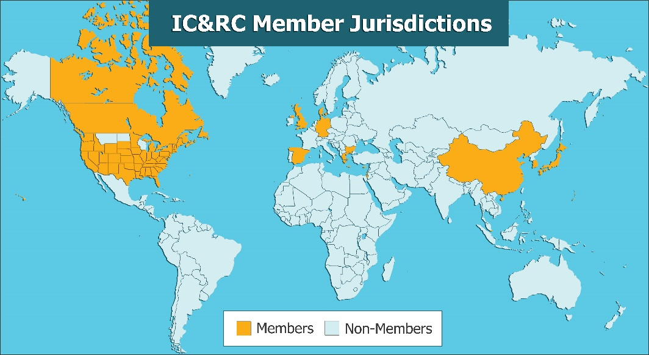
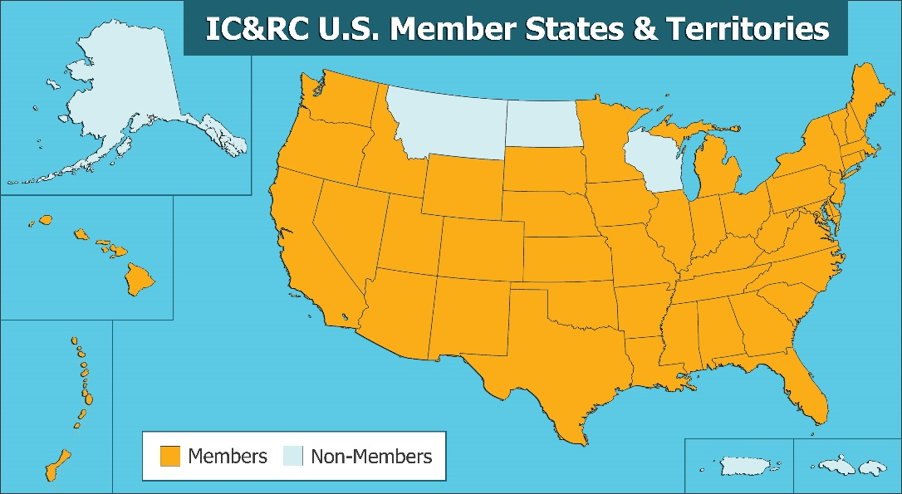
Reciprocity
Professionals that hold eligible certifications are able to transfer
their credentials between IC&RC Member Boards.
IC&RC certification boards are in 49 U.S. states and territories,
three Native American regions, all branches of the
U.S. military and 11 international regions.
https://internationalcredentialing.org/memberboards/ November 2022
Notes:
Professionals that hold eligible certifications or licenses are able to transfer their credentials between jurisdictions that use IC&RC products.
Boards may offer reciprocity to certified or licensed professionals in other jurisdictions and have the authority to set reciprocity requirements for entry to their jurisdiction.
https://internationalcredentialing.org/reciprocity https://internationalcredentialing.org/memberboards/

Slide 27
International Certificate
Holding an IC&RC recognized credential through an IC&RC Member Board can entitle you to an International Certificate.
International Certificates can be used by professionals to signify their international, reciprocal status and gain greater professional recognition.
https://internationalcredentialing.org/certifiedprofessionals November 2022

Slide 28
Current Texas Certifications
“Committed to the setting of standards and protection of the public good.”
https://www.tcbap.org/page/certification November 2022

Slide 29
Current Texas Certifications
Advanced Alcohol and Drug Counselor (AADC) *
Alcohol and Other Drug Abuse Counselor (ADC) *
Advanced Certified Prevention Specialist (ACPS) *
Certified Prevention Specialist (CPS) *
Associate Prevention Specialist (APS)
Certified Clinical Supervisor (CCS) *
Clinical Supervisor Designation (CSD)
Certified Criminal Justice Addictions Professional Applicant Status (CCJP-A)
Certified Criminal Justice Addictions Professionals (CCJP) *
Peer Recovery Support Specialist (PRSS) *
Re-Entry Peer Specialist (JI-RPS)
Mental Health Peer Specialist (MHPS)
Recovery Support Peer Specialist (RSPS)
Peer Specialist Supervisor (PSS)
* Indicates reciprocity with IC&RC

Slide 30
Alcohol and Drug Counselor
Advanced Alcohol and Drug Counselor (AADC) *
The AADC credential will separate those counselors who are content with a status quo existence from those who continue to achieve a higher level of excellence within the addiction profession.
* Indicates reciprocity with IC&RC
Notes:
These credentials upgrade and standardize qualifications of those working in the field of chemical dependency counseling.

Slide 31
Advanced Alcohol and Drug Counselor
(AADC) *
Master’s degree - Human Services Behavioral Sciences field with clinical application.
180 AOD Specific course work - 6 hrs Ethics & 6 hrs HIV/AIDS, STD’s and Hepatitis.
2,000 hours supervised work experience in Alcoholism and Drug Abuse counseling field.
300 hour Chemical Dependency Counseling Practicum.
Passing score on the ICRC AADC Exam.
* Indicates reciprocity with IC&RC
Notes:
$140 Application fee + optional $10 for IC&RC endorsement
$100 Recertification fee + optional $10 for IC&RC endorsement

Slide 32
Alcohol and Drug Counselor
Alcohol and Other Drug Abuse Counselor (ADC) *
The primary purpose of the credential is to raise the standards of education and experience levels so that individual counselors with exceptional experience or education can be duly recognized by their peers and professional organizations, statewide and nationally.
* Indicates reciprocity with IC&RC
Notes:
These credentials upgrade and standardize qualifications of those working in the field of chemical dependency counseling.
(The Texas Health & Human Services uses the ICRC International ADC Written examinations for LCDC licensure.)

Slide 33
Alcohol Drug Counselors
(ADC) *
300 hour Chemical Dependency Counseling Practicum.
270 education hours – (135 AOD, 6 HIV/AIDS, 6 Ethics).
6,000 hrs of chemical dependency counseling experience (associate’s substitutes for 1,000 hours; a bachelor’s for 2,000 hours; a master’s for 4,000 hours). Degree must be in behavioral science.
Passing score on ICRC ADC exam.
* Indicates reciprocity with IC&RC
Notes:
$140 Application fee + optional $10 for IC&RC endorsement
$100 Recertification fee + optional $10 for IC&RC endorsement

Slide 34
Prevention Specialist
Certified Prevention Specialist (CPS) *
The CPS shall be viewed as a fully qualified specialist in the area of prevention and able to provide these services independently or with minimal supervision, to the degree allowed by applicable laws, statutes and regulations.
The CPS is designed to be appropriate for those professionals currently practicing in the prevention field.
A CPS is a health care professional who has been certified by TCB as having been adequately trained to provide prevention education training.
* Indicates reciprocity with IC&RC

Slide 35
Certified Prevention Specialist
(CPS) *
120 prevention continuing education hours – (90 Prevention hrs, 24 AOD hrs, 6 Prevention Ethics hrs).
120 hour supervised Practicum.
2,000 hours Alcohol, Tobacco and Other Drug (ATOD) prevention work experience.
Passing score on the IC&RC Prevention Specialist (PS) Examination.
* Indicates reciprocity with IC&RC
Notes:
$140 Application fee + optional $10 for IC&RC endorsement
$100 Recertification fee + optional $10 for IC&RC endorsement

Slide 36
Prevention Specialist
Advanced Certified Prevention Specialist (ACPS) *
The ACPS is a TCB credential to recognize prevention specialists who have completed additional degree work.
The ACPS shall be viewed as a fully qualified specialist in the area of prevention and able to provide these services independently or with minimal supervision, to the degree allowed by applicable laws, statutes and regulations.
* Indicates reciprocity with IC&RC

Slide 37
Advanced Certified Prevention Specialists (ACPS)
200 Prevention, 24 hours Alcohol and Other Drug (AOD), 6 Prevention Ethics education hours.
AOD Work Experience - Associates Degree + 10,000 hours OR Bachelor’s, Master’s or Doctoral Degree + 4,000 hours.
120 hour supervised Practicum.
Passing score on ICRC Prevention Specialist (PS) Exam.
Notes:
$140 Application fee + optional $10 for IC&RC endorsement
$100 Recertification fee + optional $10 for IC&RC endorsement

Slide 38
Prevention Specialist
Associate Prevention Specialist (APS)
The APS designation is intended for individuals pursuing competency in the field of substance abuse prevention or those with sustained employment in the field.
APS designation is available for current prevention staff who are interested in pursuing this designation including staff currently employed at a substance abuse prevention entity.

Slide 39
Associate Prevention Specialist
(APS)
120 prevention continuing education hours - 90 Prevention, 24 AOD, 6 Prevention Ethics.
120 hour supervised Practicum.
3,000 hours of substance abuse prevention work experience.
Supervisor’s competency evaluation.
A minimum of a High School Diploma or GED.
Notes:
$100 Application fee
$100 Recertification fee
No exam

Slide 40
Criminal Justice
Certified Criminal Justice Addictions Professional Applicant Status (CCJP-A)
A CCJP-A status may be issued to an individual who has met the educational and practicum requirements for the Texas CCJP, but has not yet passed the exam and may still be working on direct service/work experience hours.
The CCJP-A applicant status will be issued for a period of five (5) years, in which time you must meet the requirements for and pass the written IC&RC CCJP exam for the full Texas CCJP.

Slide 41
Certified Criminal Justice Addictions Professional Applicant (CCJP-A)
Training/education hours – Doctoral/AAC (60+); Master’s/CCS/MAC/NASW (100+); Bachelor’s/ADC/LCDC (150+); Associate’s (200+); HS Diploma (270+).
Practicum hours – Doctoral/AAC (N/A); Master’s/CCS/MAC/NASW (80); Bachelor’s/ADC/LCDC (150); HS Diploma (200).
Passing score on IC&RC ADC Exam
  Must attempt the supplemental IC&RC CCJP exam within the first 2 years.
Notes:
$250 Application fee (includes ADC Exam fee)
$50 Recertification fee (One-time renewal)

Slide 42
Criminal Justice
Certified Criminal Justice Addictions Professionals (CCJP) *
This credential was designed in close collaboration with TCB and Criminal Justice Professionals to meet their specific and unique needs.
It is our hope that this certification will allow employers and those they serve to recognize those professionals whose expertise includes the unique blend of substance abuse issues and those related more specifically to criminal justice.
* Indicates reciprocity with IC&RC

Slide 43
Certified Criminal Justice
Addictions Professional (CCJP) *
Training/education hours – Doctoral/AAC (60+); Master’s/CCS/MAC/NASW (100+); Bachelor’s/ADC/LCDC (150+); Associate’s (200+); HS Diploma (270+).
Practicum hours – Doctoral/AAC (N/A); Master’s/CCS/MAC/NASW (80); Bachelor’s/ADC/LCDC (150); HS Diploma (200).
Work experience hours – Doctoral/AAC (1,000); Master’s/CCS/MAC/NASW (2,000); Bachelor’s/ADC/LCDC (4,000); Associate’s (5,000); HS Diploma (6,000).
Passing score on the ICRC ADC Exam and ICRC CCJP Supplemental Exam
* Indicates reciprocity with IC&RC
Notes:
$140 Application fee + optional $10 for IC&RC endorsement
$100 Recertification fee + optional $10 for IC&RC endorsement

Slide 44
Clinical Supervisor
Certified Clinical Supervisor (CCS) *
The CCS credential upgrades and standardizes qualifications of those working in the field of supervision.
In a treatment setting, the CCS shall improve the quality of supervision of interns, enhance the credibility of the practicum experience and provide greater relevance for certification.
The CCS certification is designed to be appropriate for those individuals who are currently supervising counselor interns.
* Indicates reciprocity with IC&RC

Slide 45
Certified Clinical Supervisors
(CCS) *
Current certification as an ADC, AADC, or CCJP.
10,000 hours Counseling experience in Addiction Counseling field.
4,000 hours Supervisory experience after ADC/AADC certification.
30 hours Didactic training in clinical supervision.
3 letters of reference, including one who supervised the candidate’s clinical supervision.
Passing score on the ICRC Clinical Supervision (CS) Examination.
* Indicates reciprocity with IC&RC
Notes:
$140 Application fee + optional $10 for IC&RC endorsement
$100 Recertification fee + optional $10 for IC&RC endorsement

Slide 46
Clinical Supervisor
Clinical Supervisor Designation (CSD)
The Clinical Supervisor Designation credential upgrades and standardizes qualifications of those working in the field of supervision.
In a treatment setting, the CSD shall improve the quality of supervision of interns, enhance the credibility of the practicum experience and provide greater relevance for certification.
The CS designation is designed to be appropriate for those individuals who are currently, and will be, supervising counselor interns and practicum students.
The CSD is a healthcare professional who has been designated by TCB as having been adequately trained to provide supervision for counselor interns and practicum students.
* Indicates reciprocity with IC&RC

Slide 47
Peer Support
Peer Recovery Support Specialist (PRSS) *
The PRSS credential standardizes qualifications of those working in peer recovery support within the field chemical dependency, mental health, and/or co-occurring disorders. The credential demonstrates a higher level of competency through the passing of an IC&RC exam.
* Indicates reciprocity with IC&RC

Slide 48
Peer Recovery Support Specialist
(PRSS) *
46 education hours specific to the PRS domains.
500 hours of volunteer/paid work experience.
25 hour supervised practicum.
Passing score on the ICRC Peer Recovery exam.
Minimum of a high school diploma.
* Indicates reciprocity with IC&RC
Notes:
$60 Application fee + $10 optional IC&RC endorsement
$60 Recertification fee + $10 optional IC&RC endorsement

Slide 49
Peer Support
Re-Entry Peer Specialist (JI-RPS)
Re-Entry Peer Specialists support participants with a mental health and/or substance use challenge that have been incarcerated (jail or prison) toward long-term recovery.
* Indicates reciprocity with IC&RC

Slide 50
Re-Entry Peer Specialist
(JI-RPS)
Lived experience with incarceration and demonstrate current self-directed recovery.
Successful completion of Re-Entry Peer Specialist training.
Minimum of a high school diploma.
Copy of state-issued ID.
Notes:
$60 Application fee
$60 Recertification fee

Slide 51
Peer Support
Mental Health Peer Specialist (MHPS)
The MHPS credential standardizes qualifications of those working in Recovery Support within the field of mental health, and/or co-occurring disorders.
This certification is intended for providing peer specialist services through Medicaid and applies only to peer specialist services that are Medicaid reimbursable.

Slide 52
MHPS Initial Certification
Initial Certification is good for 6 months.
  Allows professional time to earn work experience hours AFTER completing training.
Signed attestation of initial online assessment.
Signed attestation of lived experience.
Minimum education level of a high school diploma/GED.
MHPS Training from a certified Training Entity.
Background check through DPS or IdentoGO within 30 days of application date.
Copy of State Issued ID.
Notes:
$60 Application fee

Slide 53
Peer Support
Mental Health Peer Specialist (MHPS)
The MHPS credential standardizes qualifications of those working in Recovery Support within the field of mental health, and/or co-occurring disorders.
This certification is intended for providing peer specialist services through Medicaid and applies only to peer specialist services that are Medicaid reimbursable.

Slide 54
MHPS Full Certification
Minimum of 250 hours of work/volunteer experience specific to MHPS.
  Hours must be earned AFTER initial certification and completed within 6 months.
  Hours must be supervised by a certified Peer Specialist Supervisor.
  Supervisor letter of recommendation.
  No fee for Full Certification after Initial Certification.
Notes:
$60 Recertification fee

Slide 55
Peer Support
Recovery Support Peer Specialist (RSPS)
The RSPS credential standardizes qualifications of those working in Recovery Support Peer within the field of chemical dependency, mental health, and/or co-occurring disorders.
This certification is intended for providing peer specialist services through Medicaid and applies only to peer specialist services that are Medicaid reimbursable.

Slide 56
RSPS Initial Certification
Initial Certification is good for 6 months.
  Allows professional time to earn work experience hours AFTER completing training.
Signed attestation of initial online assessment.
Signed attestation of lived experience.
Verification of a minimum education level of a high school diploma.
Copy of RSPS training certificate from a certified Training Entity.
Results of background check through DPS or IdentoGO within 30 days of application date.
Copy of State Issued ID.
Notes:
$60 Application fee

Slide 57
RSPS Full Certification
Minimum of 250 hours of work/volunteer experience specific to RSPS.
  Hours must be earned AFTER initial certification and completed within 6 months.
  Hours must be supervised by a certified Peer Specialist Supervisor.
  Supervisor letter of recommendation.
  No fee for Full Certification after Initial Certification.
Notes:
$60 Recertification fee

Slide 58
Peer Support
Peer Specialist Supervisor (PSS)
The PSS credential standardizes qualifications of those working in Recovery Support Peer within the field of chemical dependency, mental health, and/or co-occurring disorders.
This certification is intended for providing peer specialist services through Medicaid and applies only to peer specialist services that are Medicaid reimbursable.
Notes:
The Peer Specialist Supervisor credential standardizes qualifications of those working in Recovery Support Peer within the field of chemical dependency, mental health, and/or co-occurring disorders. This certification is intended for providing peer specialist services through Medicaid and applies only to peer specialist services that are Medicaid reimbursable.

Slide 59
PSS Certification
Minimum education level of a High School Diploma/General Equivalency Diploma (GED).
Supervisor Training completion through an approved Training Entity.
Background check through DPS or IdentoGO within 30 days of application date.
Copy of State Issued ID.
If the applicant is a QPS- must provide record of work experience.
If the applicant is a QPS- must provide copy of MHPS or RSPS Certificate.
Copy of license depending on credentials.
Notes:
$60 Application fee
$60 Recertification fee

Slide 60
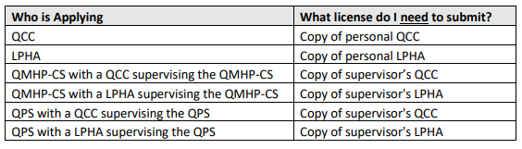
PSS Certification
Minimum education level of a High School Diploma/General Equivalency Diploma (GED).
Supervisor Training completion through an approved Training Entity
Background check through DPS or IdentoGO within 30 days of application date.
Copy of State Issued ID.
If the applicant is a QPS- must provide record of work experience.
If the applicant is a QPS- must provide copy of MHPS or RSPS Certificate.
Copy of license depending on credentials (see below)
$60 Application fee
$60 Recertification fee

Slide 61
Peer Services Training
The Training Entity
The Training Entity credential standardizes qualifications of those working in Peer Services Training within the field of substance use, mental health, and/or co-occurring disorders.
Instructor
The instructor credential standardizes qualifications of those working in Peer Services Training within the field of substance use, mental health, and/or co-occurring disorders.

Slide 62
Training Entity Requirements
Physical location in Texas.
Experience training or sponsoring training for para-professionals.
Experience training or sponsoring training that uses adult learning principles.
Experience training or sponsoring training related to elements of peer specialist services.
Plan to provide training for peer specialists, including:
Plan to provide training on a regularly scheduled basis,
Documented application process including use of HHSC-approved scoring rubric(s) for peer specialists and peer specialist supervisors,
Availability of application materials in prevalent languages, professionally translated.

Slide 63
Training Entity Requirements (continued)
Documented internal review process.
Documented fee policy.
  Use training curricula pre-approved by HHSC, including the knowledge assessment.
Provide reasonable accommodations for a person with a disability.
Provide reasonable accommodations for a person who speaks a prevalent language.
Be culturally sensitive.
Notes:
$200 Application fee
$200 Recertification fee

Slide 64
Which Certification is Right For You ?
Advanced Alcohol and Drug Counselor (AADC) *
Alcohol and Other Drug Abuse Counselor (ADC) *
Advanced Certified Prevention Specialist (ACPS) *
Certified Prevention Specialist (CPS) *
Associate Prevention Specialist (APS)
Certified Clinical Supervisor (CCS) *
Clinical Supervisor Designation (CSD)
Certified Criminal Justice Addictions Professional Applicant Status (CCJP-A)
Certified Criminal Justice Addictions Professionals (CCJP) *
Peer Recovery Support Specialist (PRSS) *
Re-Entry Peer Specialist (JI-RPS)
Mental Health Peer Specialist (MHPS)
Recovery Support Peer Specialist (RSPS)
Peer Specialist Supervisor (PSS)
* Indicates reciprocity with IC&RC

Slide 65
All Texas Certification applications and information can be found at tcbap.org
“Committed to the setting of standards and protection of the public good.”

Slide 66
Peer Mentor/Peer Recovery Coach
(PM/PRC)
46 education hours specific to the PRS domains.
500 hours of volunteer/paid work experience.
25 hour supervised practicum.
Minimum of a high school diploma.
$60 Application fee
$60 Recertification fee

Slide 67
Certified Chemical Dependency Specialist
(CCDS)
Master’s degree in a counseling related area.
Licensure or certification in the State of Texas.
4,000 hours chemical dependency supervised work experience.
135 chemical dependency counseling education hours.
Letter of recommendation from a licensed or certified colleague.
  Applicants engaged in private practice must have 2 letters of recommendation.
  $140 Application fee
  $100 Recertification fee
Notes:
Under Review - not accepting applications at this time

Slide 68
Certified Compulsive Gambling Counselor
(CCGC)
Currently certified - Alcohol Drug Counselor (ADC), Advanced Addiction Counselor (AAC), or Certified Chemical Dependency Specialist(CCDS).
30 classroom hours of training - Gambling I/Gambling II domains, with at least fifteen hours in each domain.
2 letters of recommendation from a licensed or certified colleague.
$140 Application fee
$100 Recertification fee
Notes:
Under Review - not accepting applications at this time

