Slide 1
Substance Abuse Prevention Skills Training (SAPST)
Month, YEAR
Session 3
Notes:
Welcome the participants. Introduce yourself and any other trainers—and explain your roles.
Take the time to review group guidelines.
Check on developing list of acronyms.
Suggest to mention to participants that this is a heavy content day, and they should feel free to request short stretch breaks if needed.
Use an icebreaker of the trainer’s choosing (Sandra has a list of examples)

Slide 2
This training was developed under the Substance Abuse and Mental Health Services Administration’s (SAMHSA) Center for the Application of Prevention Technologies contract. Reference #HHSS283201200024I/HHSS28342002T.
For training use only.
Version 9, September 2018

Slide 3
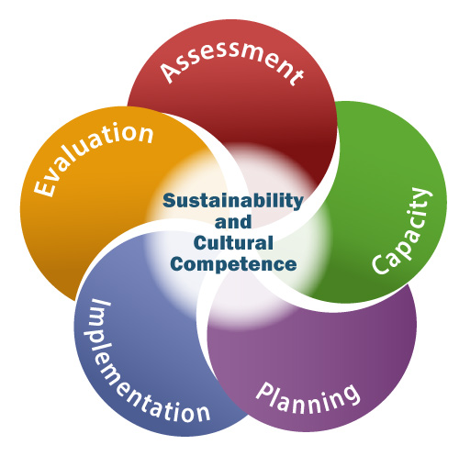
Session 3 Agenda
Review Key Concepts from Session 2
SPF Step 1: Assessment
SPF Step 2: Capacity (Assessing)
2. Strategic Prevention Framework
Step 2: Capacity (Building)
Cultural Competence
Step 3: Planning
Notes:
Let participants know that the focus of today will be on the following:
Step 2: How to build capacity
The role of cultural competence - Cultural competence is not an add-on to the process, but rather something that needs to be considered at each step.
Step 3: Planning – Planning involves using all the data collected in Step 1 to create a comprehensive plan to address the risk and protective factors for the substance abuse problems in a community, while continuing to increase the readiness and resources identified in Step 2.

Slide 4
Session 3 Learning Objectives
Explain how a community can build its capacity to prevent the problems identified in its assessment
Describe culture and how to apply cultural competence to prevention and promotion
Explain how to prioritize risk and protective factors
Notes:
Review the learning objectives for Session 3 on the slide and connect it back to the agenda:
Explain how a community can build its capacity to prevent the problems identified in its assessment.
Describe culture and how to apply cultural competence to prevention and promotion.
Explain how to prioritize risk and protective factors
List different types of interventions and describe criteria for selecting an intervention

Slide 5
ACTIVITY – Review: SPF Step 1
Get in 3 groups, with each assigned to one of the following:
Assessing behaviors and related problems
Assessing risk and protective factors
Assessing readiness and resources
As a group, write a 30-second elevator speech for your assessment task.
Present your speech to the larger group.
Notes:
Review the Strategic Prevention Framework, highlighting the following key points:
The effectiveness of the SPF begins with a clear understanding of the substance abuse and related problems in a community.
It depends on the involvement of community members from various sectors in this strategic planning process.
“Nothing about us without us” is a phrase implying that the population group that is the focus of an intervention must also be involved in the planning process.
ACTIVITY – Review: SPF Steps 1 and 2
Purpose – To have participants recap what they learned about these two steps
Total Time – 20 minutes
Instructions –
Divide participants into three groups:
Group 1 is responsible for assessing behaviors and related problems.
Group 2 is responsible for assessing risk and protective factors.
Group 3 is responsible for assessing readiness and resources.
(If there are a lot of participants, six groups may work better, with each topic assigned to two groups.)
2. Ask each group to write a 30-second elevator speech, describing their assigned topic to someone who wasn’t here yesterday.
3. After 10 minutes, have groups present their elevator speeches.

Slide 6
Building Capacity Involves…?
Increasing Resources
Improving Readiness
By…
Engaging stakeholders
Strengthening collaborative groups/partnerships
Raising awareness
Information Sheet 3.1: Building Capacity
Notes:
[In slideshow, the image automatically appears when you come to the slide]
Explain that once a community’s capacity to do prevention is assessed, the focus shifts to building capacity:
Building capacity involves increasing the resources and improving the community’s readiness to do prevention.
Building resources and readiness often go hand-in-hand—in many cases, building resource capacity also contributes to greater community readiness. For example, when key stakeholders are engaged in solving problems, they often mobilize other community members to get involved. This leads to more people recognizing the value of prevention and being ready to take action.
This section will cover three ways to increase resources and improve readiness:
Engage stakeholders
Strengthen collaborative groups/partnerships
Raise awareness
Refer participants to the Information Sheet 3.1: Building Capacity and let them know that all of this information will be discussed in the following slides.

Slide 7
Building Capacity: Engage Stakeholders
Who are the stakeholders in the community?
Notes:
There are three essential steps to building capacity: engaging stakeholders, strengthening collaborative groups/partners, and raising awareness. The first step is to engage stakeholders.
Emphasize that engaging and involving a range of partners is an essential part of prevention planning. It’s not possible to develop a comprehensive, community-based approach to prevention and wellness in isolation.
Partners are essential for the following:
Sharing information and resources
Ensuring that we reach multiple populations with multiple strategies in multiple settings
Providing us with more opportunities to achieve and claim success, and more positive outcomes that can be attributed to effective prevention interventions—which is especially important in a time of limited funding
Explain that some partners are referred to as “stakeholders.” Who are stakeholders?
Stakeholders are the people and organizations in the community who have something to gain or lose by your prevention efforts—they have a “stake” in it.
Refer back to the definition of behavioral health and point out that we may want to include stakeholders from those other areas of behavioral health, such as mental health and suicide. In addition, in some communities efforts may have mobilized around another health issue such as HIV, so groups liken this might also be another important stakeholder.
[CLICK for animation] Ask participants if they remember any of the “Faces of Prevention” from the *online SAPST component*. Explain that they represent some stakeholders.
Make the point that it’s important to foster relationships not only with traditional stakeholders but also with others in the community. Supporters or champions for prevention may be in the local media, the legislature, or the faith or business sector.
Ask participants who they would consider potential stakeholders (their responses should include the stakeholders listed on the first page of Information Sheet 3.1: Building Capacity). Record their responses on large sticky notes and put the notes on an easel paper (to use in the next slide with the involvement activity).
Ask participants:
What happens if a stakeholder group is left out or ignored?
Possible response: This question may lead to additional questions. If participants don’t mention the following, you may want point to them because they link to other parts of the SAPST: (1) How do you know that stakeholders are being left out? (connected to assessment); Why do you think they are being left out? (is the group not thinking about these stakeholders not being invited? Or is there a barrier?) If there is currently a barrier, what might hat be? If you don’t know, how could you find out more information? This sets the stage for Cultural Competency later on).
Does everyone need to be involved equally?
Possible response: This is a transitional question to the next slide that talks about levels of involvement. If no response, then you can move on to the next slide. If there are lots of answers, then base your comments on what people said and then add in what was left out.

Slide 8
Levels of Involvement¹
Collaboration
Coordination
Cooperation
Networking
No Involvement
Notes:
Emphasize that when engaging in any prevention planning process to remember that the purpose in collaborating and involving others is for reaching an ultimate goal, such as reducing alcohol use among adults. In addition, different stakeholders and community sectors will want to (and need to) be involved at different levels.
Ask if any participants can provide an example of being involved in a group that lost sight of its goal and was just meeting for the sake of meeting.
Explain the different levels of involvement: networking, cooperation, coordination, and collaboration. Refer to the second page of Information Sheet 3.1: Building Capacity
Ask participants:
Who might be involved at the networking, cooperation, and coordination levels, and who might be a full collaborator if the goal is to reduce underage drinking?
At what level of involvement would you want the specific population group that the intervention will serve? For example, if the problem in the community is prescription drug abuse among older adults, then how could this population group (older adults) be involved in prevention? What would it look like?
What do you do if someone won’t come to your meetings? (Make sure the point is made that you need to get a seat at their table—attend their meetings and participate in their efforts.)
ACTIVITY – Levels of Involvement
Time – 15 minutes
Activity Option 1
Instructions
Place flipchart paper on the walls. Write each level (“no involvement”, “networking”, etc.) on a separate piece of flipchart paper.
Instruct participants to think about a population group with which they are involved and then stand next to the flipchart paper indicating that group’s level of involvement.
Have participants answer the questions:
How does this level of involvement promote capacity building?
What are the challenges involved?
Activity Option 2
Instructions
Have participants pair off
Ask participants to think of a collaborative relationship that worked well; how did level of involvement impact the success of this relationship?
Have each pair take turns reporting out to the rest of the group.
Activity Option 3
Instructions
Large group discussion
Ask participants to examine list “Levels of Involvement”
Ask participants to describe which levels of involvement they most often/least often experience with their collaborators.
Ask participants if they think any of the levels on this list are better or worse than other levels of involvement.
Ask participants if they think it’s better to be higher up on the list, or if all levels of involvement equally valuable.

Slide 9
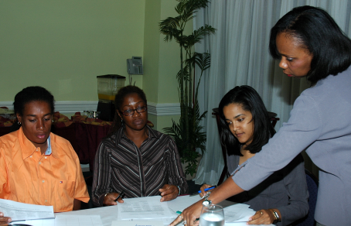
Building Capacity: Strengthen Collaborative Groups
Notes:
Explain that most communities have some kind of collaborative group—a coalition, task force, interagency group—and some communities have quite a few of them.
Have participants reflect on a group they have been part of for awhile (e.g., church or book group), and why they stay in that group. Ask them to share their reasons. These should include:
Get something out of it
Share a common mission/vision/value
Have something to give
Ask participants what they’ve learned from their own experience about strengthening task forces and other partnerships. Make sure to address the following points:
Recruiting new members so that a broad spectrum of sectors are represented. Visually represent this by drawing 3 circles on easel paper, one inside the other—the smallest, inner-most circle represents those who are most interested or have a natural affinity towards the issue (e.g., police). The other circles represent those less interested (e.g., business). Who is closest to the problem and therefore would be the most interested in collaborating? They go in the inner circle. Identify those who are less interested and place them in the middle circle, and put the least interested in the outer circle.
If participants don’t mention mental health, violence prevention, teen pregnancy prevention, or school dropout prevention, ask them which circle these groups would go in and why.
Make the point that when building membership, it is easiest to start with the inner circle, and as membership grows more members from the outer circles will get drawn in.
Increasing the knowledge of members (e.g. training and technical assistance).
Improving the structure and functioning of the collaborative group (e.g. leadership, decision-making, mission/vision, member roles).

Slide 10
Building Capacity: Raise Awareness
URGENT!!!
Notes:
[In slideshow, the word “URGENT” will flash automatically when you come to this slide]
Make the point that raising awareness of substance abuse can help to increase readiness. Connect this to the Tri-Ethnic Center Model, which was discussed the previous day.
Ask for examples of how to raise awareness about substance abuse and prevention, such as:
Highlighting data collected locally or at the national level
Media campaign to get publicity about the issue
Share an example from your own experience of how a community increased readiness to address a particular health issue, or use the following example that shows how communicating with and educating the public can increase the community’s awareness that there is a problem, and help the community understand the problem and become ready to take action to change it.
Overcoming Resistance to Zero Tolerance Policy
A local coalition had decided to implement a zero tolerance policy in its community and schools, which involved tightening up enforcement of alcohol laws involving minors and school policies punishing students in possession of alcohol or other drugs on school property. As the coalition began to implement the policy, it experienced a lot of community resistance, especially from the police, parents, and the superintendent of schools. The coalition coordinator stated, “Our failure taught us a lot about what we should have done. Instead of jumping in with a solution, we needed to raise community awareness that there even was a problem.” This coalition went on to develop a community awareness campaign called the “The Power of Know” to educate people about underage drinking and the problems it was causing, and to generate interest in taking action to protect young people from risk. When the coalition then convened a group of community leaders and citizens to explore approaches to reduce underage drinking, the police, parents, and the superintendent of schools were all in attendance and ready to talk about possible approaches, including policies and enforcement

Slide 11
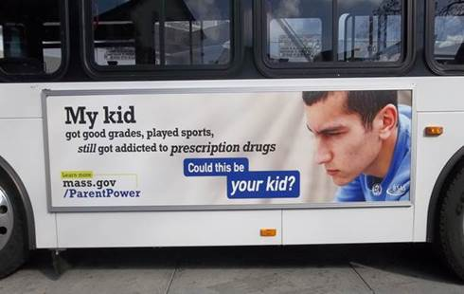
Non-medical Use of Prescription Drugs (NMUPD) Media Campaigns
Notes:
Example of media campaigns to raise awareness: Parent Power
Target: Parents of middle- and high school-aged teens in urban communities
Objective: Increase parents awareness of Rx access, addiction, and what they can do to prevent
Focused on the “not my kid” sentiment and talking to your child as a protective factor
Media: Digital, Facebook ads, billboards, transit ads, supermarkets
State without StigMA
Target: General Audience 18+ (English and Spanish)
Objective: Change the negative dialogue of addiction, that it’s a disease and recovery is possible
Featured individuals in long-term recovery
Engaged communities at a grassroots level to “Take the Pledge” against stigma
Media: Radio, TV, digital, out-of-home, Facebook, print materials
http://www.mass.gov/StateWithoutStigMA

Slide 12
ACTIVITY – Improving Readiness
Get in groups, with each assigned a specific stakeholder or sector.
Answer the following questions about your stakeholder/sector:
What information would the stakeholder/sector need to know to increase their awareness of the problem and improve their level of readiness? (e.g., data on the problem, information about prevention)
How would you get information to the stakeholder/sector? (e.g., public event, flyer, media, social media)
When would you get information to the stakeholder/sector? (e.g., when new data about the problem is available, when resources are needed)
Assign someone to report out.
Information Sheet 3.2: Strategies to Improve Community Readiness
Notes:
Explain that once key stakeholders are identified and on board, the next step is to develop or boost their level of readiness.
Share the following analogy of three blindfolded men:
The three blindfolded men are all holding on to a different part of an elephant. One feels like he is holding on to a paint brush, the other a hose, and the third a wall. They don’t see that they are all feeling a different part of an elephant. When we look at readiness, it may be that particular stakeholders are only seeing one part of the problem (the trunk), and they are not perceiving the overall problem (the whole elephant). So improving readiness may involve different things for different stakeholders.
ACTIVITY – Improving Readiness
Purpose – To have participants consider ways to improve the readiness of different stakeholders or sectors.
Time – 25 minutes
Instructions –
Assign each group a specific stakeholder group or sector (school/educators, parents/children, police, treatment, primary care, etc.). Anchor this in the case study by using the stakeholder groups identified in slide 8, the Levels of Involvement activity or in the Session 2 activity, Case Study Activity – Determining Resources & Readiness (stakeholders are churches/faith community, Latino health taskforce, hospitals, newspaper, courts, public school system, substance abuse prevention taskforce, local business association).
Have the groups discuss the following in relation to their specific stakeholder group or sector:
What information the stakeholder/sector would need to know to increase their awareness of the problem and improve their level of readiness (e.g., data on the problem in the community, information about prevention)
How to get information to the stakeholder/sector (e.g., public event, flyer, media, social media, personal phone call)
When to get information to the stakeholder/sector (e.g., when new data about the problem is available, when a task force forms, when resources are needed)
After 10-15 minutes, have each table group share their responses.
Refer participants to Information Sheet 3.2: Strategies to Improve Community Readiness, which relates to the Tri-Ethnic Center stages.
Point out that most capacity building at the community level is about increasing awareness of the problem, prevention, and wellness. This will help improve the readiness to address the problem.

Slide 13
Assessing and Building Capacity
What resources do you have AND still need to address the identified problem?
How ready are you AND your funded communities to address this problem?
CAPACITY to address the problem
Infusing Cultural Competence
Involve the priority population in efforts to raise awareness, engage stakeholders, and strengthen collaborative groups.
Notes:
Resources
We want to look at what is available in the community, particularly to serve the needs of the priority population
We will also look at what is needed and how we can build it.
Readiness
Interventions must fit to the appropriate stage of readiness
Need to move communities through the stages of readiness one at a time generally
In order to infuse cultural competency into these steps, we’ll look at things like
Examine community resources and readiness
Provide a safe and supportive environment for all participants
Examine breadth and depth of cultural competence
Check cultural representation (e.g., language, gender, age)
Develop protocols (i.e., recruitment and retention, training, communication and community input) to improve cultural competence
Ensure that tools and technology are culturally competent
Identify and mobilize mutually acceptable goals and objectives
The CLAS standards are a helpful resource for assessing and building capacity.

Slide 14
Building Capacity: The Role of Cultural and Linguistic Competence
Notes:
Introduce cultural competence and let participants know that this is an important topic which cannot be covered in-depth in this training. The focus of this training is on raising awareness about it. There are other trainings that go into much greater depth about how to practically apply cultural competence in prevention work. (NOTE: This is an important point to mention since participants may want to know more about how to apply it.)
Explain what cultural competence means and relate it to Step 2:
Cultural competence is acceptance and respect for culture that is consistently demonstrated in policies, structures, practices, and attitudes.
Provide an anchor for participants by asking them these questions:
What do you think of when I say “cultural competence”?
What are some cultural differences in your region? (Try to draw out from them the idea that culture is more than race and ethnicity—it also includes age, socioeconomic status, religion, gender, etc.)
ACTIVITY – Similarities (or use a different activity of your choice)
Time – 20 minutes
Instructions –
Have participants get into pairs and find three things that they have in common.
Have two group merge and try and find three things that they have in common.
Split the room in half by merging groups and have each half of the room find 3 other things that they have in common.
Have a few groups report out in each phase.
Summarize as follows:
When we talk about culture, we can start with what is similar and then look at the differences.
Ask participants:
What are the similarities among the various groups of people in your community?
What are the differences?

Slide 15
ACTIVITY - Your Identify
Part 1
Take 5 sticky notes and place them in front of you
On each sticky note, write a word that defines your identify.
Discuss responses with the large group.
Notes:
Part 1 Instructions:
Each participant will be provided with 5 sticky notes
Participants will be instructed to list 5 words that describe their identity – one word per sticky note
Large group discussion
Was this easy or difficult?
What type of words did you use – nouns, verbs, adjectives?
Of the words that you wrote, how many would you describe as cultural identity?

Slide 16
ACTIVITY – Your Identity (cont.)
Part 2
Select 2 cards from your 5 cards to discard and place in the center of the table.
Select 1 more card to discard.
Select 1 last card to discard.
Discuss responses with the large group.
Notes:
The purpose of this activity is to have people consider the importance of different elements of their identity.
Part 2 instructions:
Ask participants to review each of the sticky notes they have written and identify 2 that they will discard. Discarding means they will no longer have that identity.
Ask participants to discard 1 more sticky note, then to repeat this step one more time until they only have 1 sticky note in their hand.
There should be a pile of discarded sticky notes in the center of the table/room.
Large group discussion
How did you feel when you were asked to discard a piece of your identity?
Was anybody surprised with the cards you kept? Why?
Looking at the pile of discarded cards, are there any that were discarded by others that you retained in your hand? Have you ever been in a situation when you felt someone was judging you for your cards or wanted you to discard a card?
What does this activity tell us about people's cultural identities?
Transition – now lets go deeper into our discussion of culture, what it is, and how it impacts our work and how our work impacts our cultural identify.

Slide 17
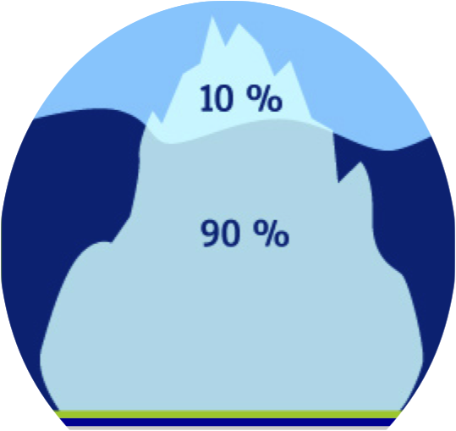
Cultural Iceberg³
Easy to See
Symbols (art, dress)
Practices/Customs
Difficult to See
Values
Beliefs
Norms
Notes:
[In slideshow, “Easy to See” will automatically appear with an arrow pointing to 10%, followed by “Difficult to See” with an arrow pointing to 90%.]
Make the following point:
Like an iceberg, some elements of culture are easy to see, but most elements of culture are hidden or difficult to see. Link this graphic to the activity they just completed and selecting what to keep and what to discard. Were there any elements that were harder to see then others

Slide 18
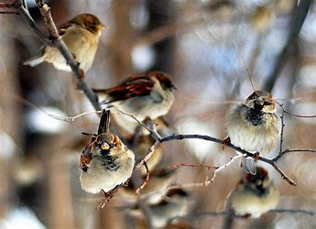
ACTIVITY – Perceptions & Differences
Notes:
ACTIVITY – Perceptions & Differences
Purpose – To explore the differences in how we perceive people of different identity groups/cultures (and the biases we have about them), even when these people are in the same life situation (e.g., experiencing addiction).
Time – 15-20 minutes including discussion
Instructions –
Ask participants to take out a sheet of paper/hand out a sheet of paper to each participant.
Describe a scenario of a white, strong and able-bodied, mid-30s male who you see walking past you on the street, intoxicated at mid-day. You see him again in the same area at the same time the next day, wearing the same clothes and in the same condition.
Give participants 1 minute to write down all the words that come to mind as they think about this person. They can write adjectives, phrases, or ideas about what this person’s life may be like.
Then say ‘Now imagine that this person is a woman’ and ask participants to take 1 minute to write down words that come to mind.
Continue the activity with 2-4 more of the following, always saying ‘Now imagine that this person is…”:
A man in his late 70s who has had both legs amputated and uses a wheelchair
A transgender female
A black male teenager
A woman dressed in heels and a business suit
Ask participants to look at their lists for each person described and notice the differences in the words they wrote down for each person. Ask if some participants would be willing to share the differences in what they wrote down and any new realizations or thoughts that came out of this activity.
Lead a discussion on how we view people differently based on the identities they hold or cultures they are a part of - or the identities and cultures we assume they belong to. Discuss that we can be biased to think of certain people in certain ways, and that these biases can impact interactions on interpersonal and organizational levels. State that it is important to be aware of the perceptions we have, the biases we hold, and the assumptions we make so that we can best support the communities we work with in culturally sensitive and relevant ways.

Slide 19
Cultural Competence⁴
Destructiveness
Incapacity
Blindness
Pre-competence
Competence
Proficiency
effort
Information Sheet 3.3: Cultural Competence
Notes:
[In slideshow, the image has animation- each step will appear individually] Wait to click on the slide animation until after you provide the introduction
Practicing cultural competence is an ongoing process that requires much time, learning, and critical reflection. Cultural competence isn’t binary, with someone being either culturally competent or culturally incompetent. Instead, it can more accurately be described on a continuum, with different levels of competence, respect, and responsiveness.
It is also very important to understand that it is unrealistic and unfair to the experiences of culturally diverse people to describe cultural competence as something you can simply ‘have’ or ‘acquire’. One cannot BE culturally competent; instead, you can practice cultural competence or apply a culturally competent framework to your personal and professional endeavors. How we do this in a given time can be described in the 5-stage continuum which we will be showing you, which was modified slightly from the National Center for Cultural Competence at Georgetown University’s Center for Child and Human Development.⁴
For each step click on the animation and it will come up on the screen
Cultural destructiveness is a stage in which attitudes and practices (as well as policies and structures in organizations) are destructive to a cultural group.
Culture incapacity describes when the capacity to respond effectively to the needs, interests, and preferences of culturally and linguistically diverse groups is lacking.
Cultural blindness is when the predominant philosophy is one that views and treats all people as the same.
Cultural pre-competence is the stage in which there is awareness of strengths and areas for growth to respond effectively to culturally and linguistically diverse populations.
Cultural competence is when acceptance and respect for culture is consistently demonstrated in policies, structures, practices, and attitudes, and when culture is held in high esteem and used as a foundation to guide all endeavors.
Ask: What does cultural proficiency look like?
Cultural Proficiency: All of the concepts of cultural competence are incorporated into an agency’s policy, practice and attitude. This agency or individual has the ability to add to the body on knowledge and to teach those concepts to others.
Cultural proficiency is a goal that few organizations reach. Depending upon the cultural context we are working within, we can move back and forth along the continuum (especially between pre-competence and competence). Ongoing assessment, performance monitoring, and evaluation are essential to ensure that we are on the right track.
Continuously revisiting your attitudes, beliefs, and behavior is key to applying cultural competency into your life and work, and being respectful and responsive to the health beliefs, practices, and cultural and linguistic needs of diverse population groups can help bring about positive health outcomes.⁴

Slide 20
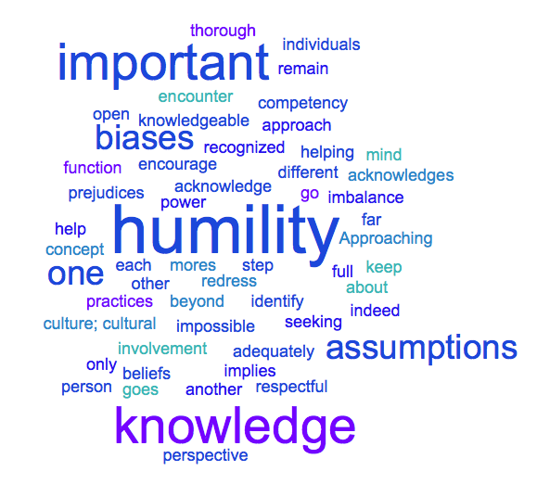
Cultural Humility: Understanding the Limits of Cultural Competence⁵
Notes:
[The slide will begin with the slide title and the definition is animated]
Ask participants if they have ever heard the term cultural humility. Ask those who have experience with the term to share what they know
[Write on flipchart paper ahead of time] Ask a volunteer to read out loud the definition or read it yourself:
“Cultural humility is a humble and respectful attitude toward individuals of other cultures that pushes one to challenge their own cultural biases, realize they cannot possibly know everything about other cultures, and approach learning about other cultures as a lifelong goal and process.”⁵
Questions: What stands out to you? What resonates with you? Pair activity – Find a partner and share your experiences with cultural humility – a time that you exhibited it, a time when you wish you had, someone who exhibited it with you or when someone did not and you wish they had.

Slide 21
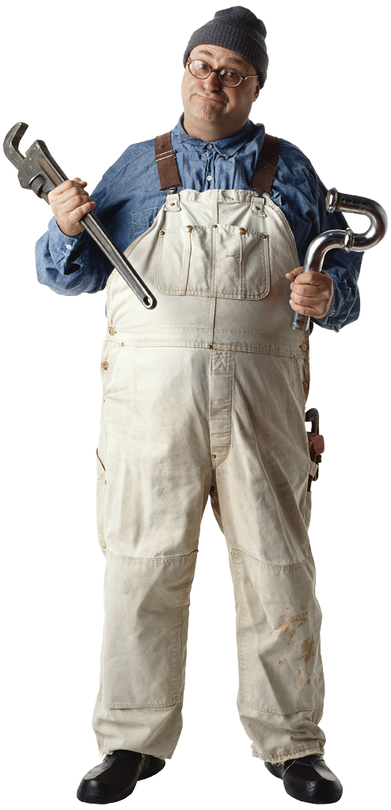
Practicing Cultural Competence
Information Sheet 3.4: Skills for Cultural Competence
Notes:
Cultural competence is an essential element to our work. It is also part of our prevention code of ethics. Under the principle of non-discrimination we are to promote cultural competence.
Refer participants to the Information Sheet 3.4: Skills for Cultural Competence for a detailed list of skills pertinent to prevention. Have them take a few minutes to read over the information sheet and circle the numbers beside the skills that they’ve had some success with, and put a check mark beside those they would like to strengthen. Give them five minutes to do this then ask for volunteers to share their successes.
Remember, developing cultural competence is an ongoing process that you need to keep working on.
Make the following summarizing points:
Professionals who are approaching the far right of the cultural competence continuum –
Appreciate diversity
Are able to function effectively among and across different cultures
Consider culture when planning and implementing prevention strategies
Cultural competence has to do with factors that include but aren’t limited to race and ethnicity.

Slide 22
ACTIVITY – Addressing Barriers to Cultural Competence
Get into 6 small groups.
Each group will be assigned a scenario regarding a challenge a prevention program is experiencing regarding their approach to cultural inclusion.
Read the scenario individually and identify the barrier.
As a small group, discuss strategies to overcome the identified obstacle.
Information Sheet 3.5: Barriers to Cultural Competence
Information Sheet 3.5a: Culturally Competent Organizations
Notes:
Assign groups or allow participants to break up into groups.
Read the instructions on the slide Summary of scenarios and barriers Scenario A You are a community coalition that has been in existence for many years. Although the Latino community and Asian community have a strong presence in your area, your coalition has never had representation from either community. You have invited representatives from both communities, but still struggle to engage them.
Scenario B You are writing a grant proposal that requires cultural diversity. You are thinking about engaging key contacts from other organizations but you fear that the relationship building will take too long and there may be needs brought up that can’t be met with this proposal. Scenario C You have engaged the Cambodian community in your coalition and several representatives have been attending the meetings. They are interested in doing activities that are not evidence-based and not allowed in your grant. Large group break out guidance:
Ask each group to read their scenario out loud and describe the barrier and how they would address it
As groups report out, presenter lists the barriers on one piece of flip chart paper and strategies on a second flip chart paper (the reason for two pieces of paper is to summarize obstacles and strategies)
After each group presents their solutions, ask other participants if they have any additional ideas
Listen and point out common strategies across barriers
After the last group reports out, summarize the barriers and ask if there are any additional that anyone can think of. Repeat this step for strategies.
Point out to participants that it’s important to provide services only on topics in which one is competent; if one is not culturally and/or linguistically competent on a given topic or with a given population or audience, practitioners are ethically responsible to either acquire those skills or find a practitioner who is culturally and linguistically competent.

Slide 23
ACTIVITY – Cultural Competence and the SPF
Get in small groups, with each assigned one of the following:
Integrating culture in assessment
Integrating culture in assessing capacity
Integrating culture in building capacity
List ways that culture should be considered in the step your group is assigned.
Discuss with the large group.
Information Sheet 3.6: Cultural Considerations in the SPF
Notes:
Connect culture to the SPF:
In each step of the Strategic Prevention Framework, culture will need to be taken into consideration to ensure that prevention is culturally relevant and effective.
ACTIVITY (Optional) – Cultural Competence and the SPF
Purpose – To give participants the chance to think about what and how cultural competence should be considered in the first two steps of the SPF.
Time – 20 minutes
Instructions –
Divide participants into groups of four to five, and assign each group one of the following:
Integrating culture in assessment
Integrating culture in assessing capacity
Integrating culture in building capacity
Ask each group to come up with a list of ways that culture should be considered in that step.
Have them write this information down.
After 10 minutes, have each group take turns sharing.
After participants have completed the activity, refer them to Information Sheet 3.6: Cultural Considerations in the SPF.
Be sure to acknowledge that culture and cultural competence is a big topic and all encouraged to seek out subsequent trainings and webinars.

Slide 24
Step 3: Planning
Notes:
Provide a transition from cultural competence to planning:
We talked about cultural competence as part of building capacity. Cultural competence is a part of Step 3: Planning as well. The cultural group(s) that the intervention will serve must be receptive to it, as well as involved in, the planning and implementation.
To anchor Step 3 in participants’ own experience, facilitate a short discussion about planning by asking them what words and images come to mind when they hear the word planning? (There can be a lot of challenges with planning, and this will raise some of these issues for discussion.)

Slide 25
Overview of Planning
Establish criteria for prioritizing risk and protective factors
Select prevention interventions
Develop a comprehensive, logical, and data-driven prevention plan
Information Sheet 3.7: Key Tasks of Planning
Notes:
Provide a an overview of Step 3: Planning.
With planning there are 3 key tasks. They are:
Establish criteria for prioritizing risk and protective factors
Select prevention interventions
Develop a comprehensive, logical, and data-driven prevention plan
Establish criteria for prioritizing risk and protective factors associated with the identified priority problems (this will be discussed next).
Select prevention interventions that are evidence-based, that are most likely to influence the identified risk factors (conceptual fit), and that are feasible and relevant to population the intervention will serve (practical fit).
Develop a comprehensive, logical, and data-driven prevention plan that includes a logic model, strategies for addressing resource and readiness gaps, anticipated evaluation activities, and how issues of cultural competence have and will be addressed.
Refer participants to Information Sheet 3.7: Key Tasks of Planning.

Slide 26
Our Road Map – Logic Model
Resources and Readiness
Problems and Related Behaviors
Risk and Protective Factors
Interventions
Notes:
Recap what has been done so far in the SPF:
Assessment data on the problems and related behaviors has been collected.
Based on this data, communities are able to select the problem(s) to address.
Data on risk and protective factors for that problem has been collected.
Information on resources and readiness has been collected.
This information will help with what will happen next:
Select interventions.
Determine the outcomes we want to achieve with these interventions.
Explain planning in relation to the logic model:
Planning is about making sure there is a connection between each of these boxes in the logic model, so that we are not picking risk and protective factors that aren’t contributing to or influencing the problems, or selecting interventions that are not associated with the risk and protective factors. (If necessary, review what risk and protective factors are.)
Explain the importance of prioritizing risk and protective factors:
Before selecting interventions, decide which risk and protective factors to target by prioritizing them, since its not possible to address them all.

Slide 27
Prioritizing Risk and Protective Factors
Importance
Changeability
Information Sheet 3.8: Prioritizing Risk and Protective Factors
Notes:
Think about an important change that you’d like to make in your living space
How important is the change to you, on a scale of 1-5 (one being lowest, five highest)?
What resources do you have and how ready are you to make the change? On a scale of 1-5
(Resources include money, assistance, time, energy, skills, etc.)
Explain that different criteria can be used to prioritize risk and protective factors, and this training will focus on two criteria:
Importance
Changeability
Point out that the epidemiological data collected during Step 1 will be used to determine importance and changeability. (Each concept will be described in the following slides.)
Refer participants to Information Sheet 3.8: Prioritizing Risk and Protective Factors when covering the information on the following two slides.
[TRAINER TIP: Use the word “assessment” as much as you can to reinforce SPF Step 1 (e.g. assessment data)]

Slide 28
Importance
High Importance
Low Importance
How much is the risk/protective factor influencing the problem?
Does it influence other behavioral health issues?
Does it directly impact the developmental stage of the population?
Notes:
Describe Importance:
Importance looks at how much a risk or protective factor is impacting the problem in the community.
To help determine the level of importance when examining the data collected, ask the question, “How important is a particular risk or protective factor in reducing the problem in the community?”
If the answer is “very important,” then this would be considered high importance.
If it is “not very important,” then it would be considered low importance.
For example, with the problem of underage drinking, if the data showed that lots of youth are obtaining alcohol from stores (referred to as retail access) rather than from their homes or peers (referred to as social access), then retail access would be considered high importance, whereas social access would be considered low importance.
[In slideshow, click the slide and all three questions will appear—the previous question and the next two.]
Also be sure to consider the following information about importance:
Influence on other behavioral health issues – Does the risk or protective factor influence other behavioral health issues? Refer back to the first day, which addressed shared risk and protective factors for substance abuse and other issues. The importance is higher when a risk or protective factor influences multiple behavioral health issues.
Impact on developmental stage – Does the risk or protective factor directly impact the specific developmental stage of the population group that is experiencing the problem? For example, if the problem is underage drinking among 18 to 20 year olds, then the risk factor low parental monitoring around drinking behavior would probably have less impact for this developmental stage than it would for a population group of 14 to 17 year olds, so parental monitoring would be considered low importance.

Slide 29
Changeability
High Changeability
Low Changeability
Is there adequate capacity to change the risk/protective factor?
Does a suitable evidence-based intervention exist?
Can change occur in a reasonable amount of time?
Notes:
[In slideshow, click the slide and all three questions will appear that relate to the following three points.]
Explain that changeability looks at the following:
Does the community have the capacity—readiness and resources—to change a particular risk or protective factor?
Is there a suitable evidence-based intervention that will address the risk or protective factor? (This will be discussed in greater detail on Slide 31.)
Is it possible to change the risk or protective factor in a reasonable time frame? Changing some risk or protective factors may take too long to be a practical solution.
The risk/protective factor would be considered to have high changeability if:
The community has ample resources.
Sufficient readiness exists to address this risk or protective factor.
A suitable evidence-based intervention exists.
Change can occur within a reasonable time frame.
It would be considered to have low changeability if resources are inadequate or the community is not ready to address the risk or protective factor.
You may want to acknowledge that there may be other interpretations of changeability (e.g., epidemiologists would define it differently).
Summarize as follows:
Communities will want to select risk or protective factors that fall in the high category for both importance and changeability.
Communities will probably not want to address factors that are high for changeability but low for importance.
You may also want to discuss the following dilemmas:
What happens when a community identifies two factors that are both high for importance and changeability? (e.g. Your collaborative group may want to choose the factor that is most doable in a short amount of time first.)
What happens if no factors are high for both importance and changeability? (e.g. Select the factor that that is most changeable and then take a step back in your planning and determine how to build your resources before you move on.)

Slide 30
Case Study: Review Assessment Information
Case Study
Community
Worksheet 3.9: Case Study – Assessment Information
Notes:
[In slideshow, “Community” and the arrow will automatically appear when you come to this slide.]
Introduce participants to the entire case study and let them know they will be using the information from this case in the next activity.
Ask participants to look at Worksheet 3.9: Case Study – Assessment Information
Explain that this case provides a good example of how to present the data collected in a community so that people can look at it and make decisions.
Consider having volunteers read different sections or pages or have them read by themselves and underline key points. Allow time for people to read worksheet 3.9.

Slide 31
CASE STUDY ACTIVITY – Prioritizing Risk Factors
In case study groups, circle your assigned risk factor on the top of Worksheet 3.9: Case Study – Assessment Information
Find the assessment data on your assigned risk factor on Worksheet 3.9. Circle the data.
Locate and remove Worksheet 3.10: Case Study Activity – Prioritizing Risk Factors from your manual. Circle your assigned risk factor at the top of Worksheet 3.10.
Find the Importance section of Worksheet 3.10. Use the data on your assigned risk factor to answer questions 3-6.
Mark the box indicating whether your risk factor is of high or low importance.
Worksheet 3.9: Case Study – Assessment Information
Worksheet 3.10: Case Study Activity – Prioritizing Risk and Protective Factors
Notes:
CASE STUDY ACTIVITY – Prioritizing Risk Factors
Purpose – The purpose of this case study activity is for participants to work together at their tables and apply the criteria of changeability and importance to a risk factor in their case study community. This activity is broken into three parts and takes a total of 30 minutes.
Part 1
Time – 10 minutes
Instructions –
Ask participants to get back into their small case study groups and direct them to Worksheet 3.9: Case Study – Assessment Information.
Assign each case study group one of the following three risk factors: parental monitoring, social access, or perception of harm. Have them circle their assigned risk factor on Worksheet 3.9.
Then show participants where the assessment data for their assigned risk factor can be found on Worksheet 3.9. Have them circle the data on their assigned risk factor.
Have participants find Worksheet 3.10: Case Study Activity – Prioritizing Risk Factors and remove it from their manuals. Show participants where the risk factors are listed at the top of Worksheet 3.10. Have them circle their assigned risk factor.
Point to the Importance section of Worksheet 3.10 and explain that they will answer questions #3-6 and mark the box indicating whether they think their risk factor is of high or low importance. Allow 10 minutes.

Slide 32
CASE STUDY ACTIVITY – Prioritizing Risk Factors (cont.)
Find the assessment information on Resources and Readiness for Community XYZ on Worksheet 3.10: Case Study Activity – Prioritizing Risk Factors
Find the Changeability section of Worksheet 3.10. Use the data on Resources and Readiness to answer questions 7-9.
Mark the box indicating whether your risk factor is of high or low changeability.
Worksheet 3.9: Case Study – Assessment Information
Worksheet 3.10: Case Study Activity – Prioritizing Risk and Protective Factors
Notes:
CASE STUDY ACTIVITY – Prioritizing Risk Factors (Part 2)
Time – 10 minutes
Instructions –
Hold up Worksheet 3.9. and show participants where to find the assessment information on resources and readiness (p. 19-20) for Community XYZ.
Hold up Worksheet 3.10 Point to the Changeability section of Worksheet 3.10 and explain that they will answer questions #7-9 and mark the box indicating whether they think their risk factor is of high or low changeability
Allow 10 minutes for groups to do this now
Have them fill out the box for prioritization on Worksheet 3.10, using the answers they recorded about the importance and changeability of their risk factor.

Slide 33
CASE STUDY ACTIVITY – Prioritizing Risk Factors (cont.)
Find the Prioritization box on Worksheet 3.10.
Place an “x” in the quadrant that represents your risk factor:
High or low importance
High or low changeability
Write the name of your risk factor on a sticky note and place it in the correct quadrant on the Prioritization box on the easel
Be prepared to share your rationale:
What risk factor data led you to rate your risk factor high/low importance?
What capacity data led you to rate your risk factor high/low changeability?
Worksheet 3.10: Case Study Activity – Prioritizing Risk and Protective Factors
Notes:
CASE STUDY ACTIVITY – Prioritizing Risk Factors (part 3)
Time – 10 minutes
Instructions –
Point to the Prioritization box on Worksheet 3.10 and show them how to place their risk factor according to whether it is high or low Importance and high or low Changeability – have groups do this now.
Draw a large Prioritization box on a page of easel paper and have each group post their risk factor in the appropriate quadrant and share their rationale. Use a different color sticky note for each risk factor (this will become important as you continue to build the sample logic model for Community XYZ on the wall over the course of the training).
Then, ask which risk factor(s) Community XYZ should address first (those in the high/high quadrant). If no risk factor was scored high/high, ask what the community could do (e.g., increase readiness, increase resources, identify risk factors that are contributing more directly to underage drinking, etc.).
Point out that the prioritization process in this activity has been piloted in communities, and so participants can use this tool in their work.
Finally, have groups write their risk factor on the logic model on the wall on the easel page marked “Risk and Protective Factors.” Each group will use a different color marker. (They will continue to use the same color marker as they develop the logic model for Community XYZ on the wall throughout the training).

Slide 34
Session 3 Learning Objectives
Explain how a community can build its capacity to prevent the problems identified in its assessment
Describe culture and how to apply cultural competence to prevention and promotion
Explain how to prioritize risk and protective factors
Notes:
Ask participants to summarize the key things they learned in the training today about the following:
Building capacity
Cultural competence
Review the learning objectives on the slide and ask participants how well the objectives were met.
Explain how a community can build its capacity to prevent the problems identified in its assessment
Describe culture and how to apply cultural competence to prevention and promotion
Explain how to prioritize risk and protective factors
Address any outstanding issues.

Slide 35
Questions or comments?
Notes:
Point out to participants that in their handouts is a list of additional resources and materials on the topics covered in the training today.
ACTIVITY (Optional) – What You Learned
1. Ask participants to write down something they learned or re-learned.

Slide 36
Session 3 References
Butterfoss, F. D. (2007). Coalitions and partnerships in public health. San Francisco, CA: John Wiley & Sons, Inc.
U.S. Department of Health and Human Services, Office of Minority Health. (2018, June 11). Cultural competency [Website]. Retrieved from https://minorityhealth.hhs.gov/omh/browse.aspx?lvl=1&lvlid=6
Griswold, W. (2008). Cultures and societies in a changing world (3rd ed.). Thousand Oaks, CA: Pine Forge Press.
National Center for Cultural Competence, Georgetown University Center for Child and Human Development. (2004). A guide to infusing cultural & linguistic competence in health promotion training. Retrieved from https://nccc.georgetown.edu/video-infusing-clc/continuum.pdf
Levi, A. (2009). The ethics of nursing student international clinical experiences. Journal of Obstetric, Gynecologic, and Neonatal Nursing, 38(1), 94-99.
See the final page of the Session 3 Handouts document for additional references not listed on these slides.

