Slide 1
A Look Back at Our Journey
Notes:
These slides are optional—you may want to use them to review what was covered in the SAPST.
(NOTE: These slides are automated and will proceed to the next slide every 3 seconds, in slide show. )
Explain to participants that these slides show the journey they have been on over the past four days of this training.
_______________
IMAGE: http://www.imageafter.com/image.php?image=b13nature_landscapes074.jpg

Slide 2
Eight Dimensions of Wellness
Emotional
Physical
Intellectual
Environmental
Financial
Social
Spiritual
Occupational
Notes:
Introduce the Eight Dimensions of Wellness by comparing it to the spokes of a wheel. Making the following point:
In order to be well, all the dimensions of our life have to be balanced, like the spoke of a wheel. If the spokes are uneven then the wheel won’t turn. And that’s what happens in life when we are out of balance.
Refer participants to the Information Sheet 1.4: Eight Dimensions of Wellness. Refer to this handout to discuss how wellness connects to behavioral health, and relate this to both individuals and systems.
Discuss the dimensions of wellness. Ask participants:
Is there anything missing from this wheel that impacts wellness?
How does culture influence wellness?
Where does family fit in this wheel?
Refer to Worksheet 1.5: Activity – Your Eight Dimensions, and ask participants to fill in the wheel with the 8 spokes/dimensions of wellness according to how big that dimension is in their life. Have them look at which spoke/dimensions are big and which are small. Process the answers in pairs or with the entire group.
Discuss when the dimensions of wellness are not balanced and ways to get them more in balance.

Slide 3
Continuum of Care
Treatment
Prevention
Recovery
Indicated
Case Identification
Selective
Maintenance
Standard Treatment
Promotion
Universal
Long-Term Treatment
Promotion
After-care and Rehabilitation
Promotion
After-care and Rehabilitation
Promotion
Notes:
Draw the continuum of care model on easel paper so that you have it to refer to throughout the training.
Refer participants to Information Sheet 1.6: The Continuum of Care.
Make the following overview statements:
This model was first presented by the Institute of Medicine in 1994 as the mental health intervention spectrum, and it was expanded in 2009 to include promotion.
The continuum of care describes the scope of behavioral health services for individuals before, during, and after they experience a behavioral health problem or disorder. It includes promotion, prevention, treatment, and maintenance.
The continuum segments the need for care and the type of care required from various parts of the health care system. This means there are multiple opportunities for addressing behavioral health problems.
The continuum underscores the interrelationship among promotion, prevention, treatment, and maintenance. While some services may be more specific, individualized, or costly than others, it shows that each phase along the continuum does not exist in isolation.
Ask participants to raise their hands if they have seen the continuum of care diagram before.
_______________
Image reprinted with permission from the National Academy of Sciences, Courtesy of the National Academies Press, Washington, D.C.

Slide 4
Risk Factor
A characteristic at the
biological, psychological, family, community, or cultural level
that precedes and is associated with
a higher likelihood of
problem outcomes
Notes:
Provide an anchor for risk and protective factors:
Framingham Heart Study
Dr. Dawber was the first director of the Framingham Heart Study, one of the most important research projects of the 20th century. The study, which Dawber led from 1949 to 1966, found links between vascular diseases (the leading cause of death in the United States) and diet, blood pressure, obesity, exercise, and smoking. He coined the term risk factor in 1961, and that term has now been applied to other diseases, disorders, circumstances, and events.
Segue to risk and protective factors for substance abuse with Hawkins & Catalano:
In the 1980s, Drs. David Hawkins and Richard Catalano at the University of Washington compiled risk and protective factors for substance abuse and other problems occurring in adolescence.
Ask participants to read the definition of risk factor on the slide:
“A characteristic at the biological, psychological, family, community, or cultural level that precedes and is associated with a higher likelihood of problem outcomes.”¹⁵
Refer back to the malaria example or to the fish/pond analogy, and ask participants for examples of risk factors.

Slide 5
Protective Factor
A characteristic
at the individual, family
or community level
that is associated with
a lower likelihood of
problem outcomes
Notes:
Ask participants to read the definition of protective factor on the slide:
“A characteristic at the individual, family or community level that is associated with a lower likelihood of problem outcomes.”¹⁶
Refer back to the malaria example or to the fish/pond analogy, and ask participants for examples of protective factors.
Emphasize the following:
Protective factors can reduce the negative impact of risk factors.
Resilience is the ability to recover from or adapt to adverse events, and is therefore protective.
Culture can be a protective factor. (NOTE: Unlike the definition of risk factor, this definition from the Institute of Medicine does not include a cultural level. But as the trainer, you can add this component when discussing the definition.)
Prevention is not just about eliminating a negative behavior, it is also about supporting protective factors and striving to optimize well-being.

Slide 6
Multiple Contexts
Individual
Family
Community
Society
Notes:
Point out to participants that the graphic on this slide shows the different contexts that have an influence on people’s health: individual, family, community (including school or work), and society.¹⁷ (Some participants may be more familiar with the term domains, which refers to essentially the same idea.)
Make the following points that connect to risk and protective factors:
Individuals have biological and psychological characteristics that put them at risk for, or protect them from, mental, emotional, and behavioral problems. For example, some risk factors include genetic predisposition to addiction or exposure to alcohol prenatally. Protective factors include positive self-image, self-control, and social competence.
Individuals don’t exist in isolation. They are part of families, communities, and society. Within each of these contexts, there exists a variety of risk and protective factors:
Within families, examples of risk factors include child abuse and maltreatment, inadequate supervision, parents who use drugs and alcohol or who suffer from mental illness. A protective factor would be parental involvement.
Within communities, examples of risk factors include neighborhood poverty and violence. Protective factors might include availability of afterschool activities or positive relationships with adult mentors in the community.
Within society, examples of risk factors include norms and laws favorable to substance use, as well as racism and/or lack of economic opportunity. Protective factors include policies limiting availability of substances and laws protecting marginalized populations such as LGBT youth.
Make these conclusions:
Since multiple contexts influence people’s lives, multiple interventions are necessary to reduce substance abuse and to promote emotional well-being.
Since multiple contexts influence health and well-being, it’s important to collaborate with professionals in different sectors of the community, such as education, justice, and law enforcement.
Ask participants for some examples of substance abuse prevention interventions in these different contexts.

Slide 7
Developmental Perspective
Young Adulthood
Adolescence
Middle Childhood
Early Child-hood
Middle Adulthood
Older Adulthood
Notes:
Connect the developmental perspective to risk and protective factors and to the multiple contexts that influence health.
Make the following points:
The developmental perspective looks at risk and protective factors and their potential consequences and benefits according to defined developmental periods.
Different age groups have different risk and protective factors.
In every developmental period, the risk and protective factors vary within each context.
Some risk and protective factors overlap age groups, although the risk and protective factors for adulthood vary from those for childhood.
Describe the developmental perspective to participants, making the following points:
As children grow, they progress through a series of developmental periods. Each period is associated with a specific set of developmental competencies: cognitive, emotional, and behavioral abilities.
Development might look different in different cultures and with people who have disabilities.
People must learn to adapt to new challenges and experiences in each developmental period. Certain risk and protective factors affect healthy development at different periods.
Trauma and stressful life events can occur during any period of development; however, trauma in youth can impact adult development.
Transitioning from one stage to another brings new stresses.
Explain why understanding this perspective is important to substance abuse prevention:
People are more vulnerable to substance abuse and other behavioral health problems when they have experienced untreated, unresolved trauma.
Prevention efforts that are aligned with key periods in young peoples’ development are most likely to produce the desired, long-term positive effects.
Connect to the online component of the SAPST by asking participants the following:
From what you learned in the online component, why do we focus on the early/middle childhood stages in our work?
Ask participants for some examples of substance abuse prevention interventions that are developmentally appropriate.
Refer participants to Information Sheet 1.10: Developmental Perspective for additional information or explanation.

Slide 8
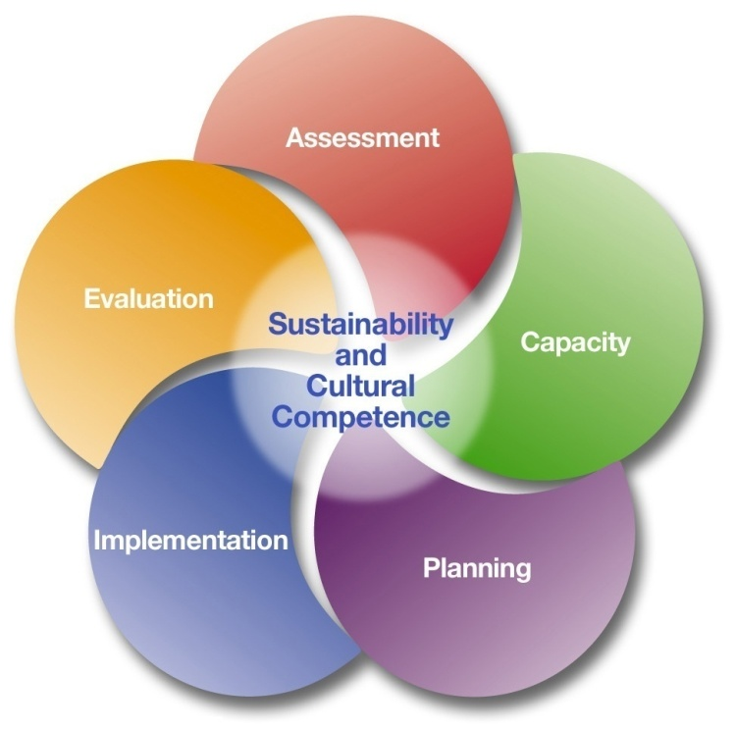
Strategic Prevention Framework
Notes:
Connect the public health questions to the Strategic Prevention Framework (SPF) by explaining that:
The SPF answers the public health question, “How will we do substance abuse prevention?”
The SPF is a strategic planning process that SAMHSA’s Center for Substance Abuse Prevention (CSAP) uses to guide communities and states in developing and implementing comprehensive substance abuse prevention activities.
Ask participants to raise their hands if they have been to a workshop or training on the Strategic Prevention Framework—or SPF.
If a large percentage say yes, then consider a review of the SPF in the following way:
Break up participants into 7 groups.
Assign each group one of the five steps, sustainability, or cultural competency.
Within their group, have participants discuss what they know about that step, sustainability, or cultural competence.
Provide an example from a community that has gone through all of the steps.
Integrate audience knowledge of the overall SPF into the following overview statements (lead with the audience’s knowledge):
The SPF is a 5-step planning process to guide the selection, implementation, and evaluation of effective, culturally appropriate, and sustainable prevention activities. (Provide examples of each step.)
In the middle of the SPF graphic is Sustainability and Cultural Competence. Ask participants:
How can culture impact this process?
What do you think of when I say sustainability?
The effectiveness of the SPF begins with a clear understanding of the specific substance abuse problems in a community, and it depends on the involvement of community members in all stages of the process.
The SPF is dynamic, deliberate, and ongoing, but it isn’t always a linear process. Steps may be repeated or performed out of order. Each of the steps will be explained in greater detail later in the training.

Slide 9
Step 1: Assessment
Notes:
Refer back to the public health questions:
Assessment answers these Public Health questions:
What? – What substance abuse and other behavioral problems need to be addressed?
Who? – Who will the intervention(s) focus on—will it be the entire population or a specific population group?
When? – This refers to the specific developmental stage of the population group that the interventions focus on (i.e., teenagers, young adults, older adults).
Where? – Where should the interventions take place? Prevention needs to take place in multiple contexts that influence health and where risk and protective factors can be found—in families, communities, and society.
Why? – Why are these problems occurring? This refers to the risk and protective factors.
Explain that Step 1 is a Needs Assessment:
This step is sometimes referred to as a Needs Assessment because once the assessment is completed for a community, you will have a better sense of its prevention needs.

Slide 10
Our Road Map – Logic Model
Resources and Readiness
Problems and Related Behaviors
Risk and Protective Factors
Interventions
Consequences and Consumption
Intervening Variables/ Causal Factors
Interventions/ Strategies
Notes:
Explain the logic model and connect it to epidemiology:
The logic model is the “roadmap” we use, and the first stop is assessing substance use—its problems and related behaviors
Epidemiology is how we do the assessment
Reflect on how prevention was done in the past:
In the past, when looking at the problems faced by communities, we typically went straight to finding solutions and selecting interventions. However, the SPF process recommends that we do the following:
Use data to learn about the problems in a community.
Look at the factors that influence and contribute to the problem.
Once we know what the problem and the risk factors are—based on data—then we can select the best possible interventions.
Provide an example (e.g., it may appear that the problem/related behavior in a community is adult drinking, but the data from traffic fatalities shows that it’s actually underage drinking, and the risk factors may include social access).
Point out that the assessment relates to the first two parts of the logic model:
Problems and related behaviors
Risk and protective factors
[In slideshow, click for other terms to appear.]
Make the point that the terms used in these boxes may vary:
Some people may think of problems and related behaviors as consequences and consumption
Some people may think of risk and protective factors as intervening variables or causal factors
Some people may think of interventions as strategies
Summarize as follows:
The current logic model provides a broader framework for addressing substance use problems.
Post the Road Map Logic Model Poster for duration of the session.
Suggested talking point:
If the question comes up from participants about the logic model template we use in the SAPST, say “We have combined certain aspects of our logic model together to make our template clear and easy to use. Other logic models may also include additional elements like “local conditions” or ask you to answer the question, “why here?” relating to the substance use problems that you are seeing in your community. There are many logic model formats that can be used effectively, but for the purposes of this training we are going to use this format.

Slide 11
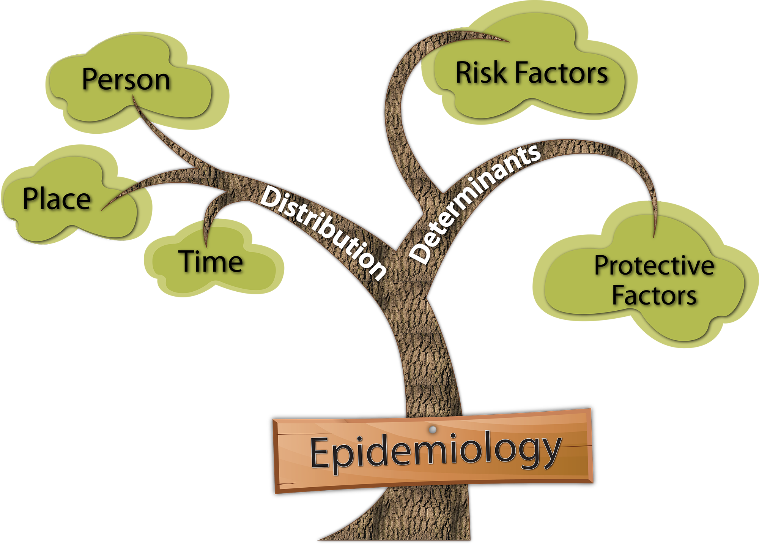
What is Epidemiology?
Notes:
Write out the definition of epidemiology on easel paper:
Epidemiology is concerned with the distribution and determinants of health in populations.¹
Provide an anchor by referring to the detective analogy (as a detective we use epidemiology to uncover the behaviors and related problems) or use the flu example (be sure to include who gets it [person], where [place], and when [time]).
Make the point that epidemiology is used in public health.
Ask participants:
What do you know about epidemiology?
Discuss distribution. Provide an example that you can refer to when explaining what it means (e.g., youth aged 14–18 who live in a particular county that has seen rates of motor vehicle crashes increasing over the last three years).²
Distribution is any particular behavioral problem and/or disease distributed in a certain location over a certain period.²
- Person: What populations are affected most?
- Place: What geographic areas are most affected?
- Time: Are problems increasing or decreasing over time?
Ask participants for examples of distribution.
Discuss determinants:
Determinants are the factors that influence health and disease—the risk and protective factors (discussed previously).
Refer participants to Information Sheet 2.1: Key Concepts for Step 1, which has information on assessment, epidemiology, and the logic model.

Slide 12
Step 2: Capacity
Notes:
Let participants know that Step 2 focuses on capacity:
Capacity refers to resources and readiness.
Step 2 is about assessing and building a community’s readiness to address the issues identified in the assessment, and the resources it already has and needs to address the problem and its risk and protective factors.
Today the focus is on assessing a community’s capacity and tomorrow will focus on building a community’s capacity.

Slide 13
Assessing Capacity
RESOURCES
Readiness
CAPACITY
Notes:
Explain that once the problems and risk factors have been assessed and identified, the next thing to do is to assess a community’s capacity. (Remember that sometimes this comes under Step 1 since it involves assessment.)
Reiterate that capacity includes both of the following:
The resources a community has to address its problems (e.g., programs, organizations, people, money, expertise)
How ready the community is to take action and address its problems
Ask participants why communities would assess their capacity (resources and readiness) before they begin to plan what interventions to use.
Be sure to mention the following key points about why assessing capacity comes before planning:
To make a realistic match between the problems identified and the resources available and/or needed to address the problems and their risk factors
To discover strengths and shortfalls in key resources, such as funding, people’s skills, people’s ability to work collaboratively
To provide an opportunity to address any shortfalls or gaps in resources in advance
To provide an understanding of how resources and readiness may influence the planning, selection, and adaptation of an intervention

Slide 14
Cultural Competence
Cultural Competence
Cultural Pre-Competence
Cultural Blindness
Cultural Incapacity
Cultural Destructiveness
Notes:
[In slideshow, the image has animation- each step will appear individually] Wait to click on the slide animation until after you provide the introduction
Practicing cultural competence is an ongoing process that requires much time, learning, and critical reflection. Cultural competence isn’t binary, with someone being either culturally competent or culturally incompetent. Instead, it can more accurately be described on a continuum, with different levels of competence, respect, and responsiveness.
It is also very important to understand that it is unrealistic and unfair to the experiences of culturally diverse people to describe cultural competence as something you can simply ‘have’ or ‘acquire’. One cannot BE culturally competent; instead, you can practice cultural competence or apply a culturally competent framework to your personal and professional endeavors. How we do this in a given time can be described in the 5-stage continuum which we will be showing you, which was modified slightly from the National Center for Cultural Competence at Georgetown University’s Center for Child and Human Development.⁴
For each step click on the animation and it will come up on the screen
Cultural destructiveness is a stage in which attitudes and practices (as well as policies and structures in organizations) are destructive to a cultural group.
Culture incapacity describes when the capacity to respond effectively to the needs, interests, and preferences of culturally and linguistically diverse groups is lacking.
Cultural blindness is when the predominant philosophy is one that views and treats all people as the same.
Cultural pre-competence is the stage in which there is awareness of strengths and areas for growth to respond effectively to culturally and linguistically diverse populations.
Cultural competence is when acceptance and respect for culture is consistently demonstrated in policies, structures, practices, and attitudes, and when culture is held in high esteem and used as a foundation to guide all endeavors
Continuously revisiting your attitudes, beliefs, and behavior is key to applying cultural competency into your life and work, and being respectful and responsive to the health beliefs, practices, and cultural and linguistic needs of diverse population groups can help bring about positive health outcomes.⁴
Activity – Levels of Involvement
Time – 15 minutes
Instructions
Place flipchart paper on the walls. Write each level (“cultural destructiveness”, “cultural incapacity”, etc.) on pages of flipchart paper.
Instruct participants to think about a population group with which they are involved and then stand next to the flipchart page indicating that group’s level of involvement.
Have participants answer these questions:
How does this level of involvement promote capacity building?
What are the challenges involved?

Slide 15
Step 3: Planning
Notes:
Provide a transition from cultural competence to planning:
We talked about cultural competence as part of building capacity. But cultural competence is a part of Step 3: Planning and the last two steps as well.
To anchor Step 3 in participants’ own experience, facilitate a short discussion about “planning” by asking them what words and images come to mind when they hear the word “planning?” (There can be a lot of challenges with planning, and this will raise some of these issues for discussion.)

Slide 16
Our Road Map – Logic Model
Resources and Readiness
Problems and Related Behaviors
Risk and Protective Factors
Interventions
Notes:
Recap what has been done so far in the SPF:
Assessment data on the problems and related behaviors has been collected.
Based on this data, communities are able to select the problem(s) to address.
Data on risk and protective factors for that problem has been collected.
Information on resources and readiness has been collected.
This information will help with what will happen next:
Select interventions.
Determine the outcomes we want to achieve with these interventions.
Explain planning in relation to the logic model:
Planning is about making sure there is a connection between each of these boxes in the logic model, so that we are not picking risk and protective factors that aren’t contributing to or influencing the problems, or selecting interventions that are not associated with the risk and protective factors. (If necessary, review what risk and protective factors are.)
Explain the importance of prioritizing risk and protective factors:
Before selecting interventions, decide which risk and protective factors to target by prioritizing them, since its not possible to address them all.

Slide 17
Prioritizing Risk and Protective Factors
Importance
Changeability
Notes:
Explain that different criteria can be used to prioritize risk and protective factors, and this training will focus on two criteria:
Importance
Changeability
Point out that the epidemiological data collected during Step 1 will be used to determine importance and changeability. (Each concept will be described in the following slides.)
Refer participants to Information Sheet 3.8: Prioritizing Risk and Protective Factors when covering the information on the following two slides.

Slide 18
Our Road Map – Logic Model
Resources and Readiness
Problems and Related Behaviors
Risk and Protective Factors
Interventions
Notes:
Refer to the Logic Model on the slide and point out where we are now on this “map”—select interventions.
Refer back to the online SAPST component and the history of prevention. Note that early in the history of prevention, interventions were selected based on our best guesses as to what would be effective, but the field has evolved to the point where we have evidence of effectiveness for many types of interventions now.
Make the following point about a comprehensive plan:
A comprehensive prevention plan will include multiple risk and protective factors and interventions to address them. Interventions may be universal, selective or indicated (which were discussed in the first session).
Ask if anyone can remember the difference between universal, selective and indicated interventions.

Slide 19
Selecting Interventions: Things to Consider
Effectiveness
Is the intervention effective?
Conceptual Fit
Will the intervention impact the selected risk factor?
Practical Fit
Is the intervention feasible for the community?
Notes:
Refer back to the prioritization process by explaining that communities will select interventions that address the risk factor they chose during the prioritization process. For example, if a community’s problem is underage drinking and their priority risk factor is retail access, then they will want to find and put in place interventions that address retail access.
Ask participants for some of the reasons that communities select a specific program, practice, or environmental strategy. Connect their responses to the following information about the three criteria to consider when selecting an intervention:⁸
[In slideshow, click on the slide so the following information appears.]
Evidence of Effectiveness refers to whether an intervention has evidence—based on research—showing that it is effective.
Conceptual fit refers to the relevance of a specific type of intervention (e.g., educating merchants is a different type of intervention from a media campaign).
Practical fit refers to the appropriateness of a specific intervention for a certain community (e.g., a community may not be receptive to a certain policy change, or a school may not be receptive to a particular curriculum).
Refer participants to Information Sheet 3.12: Criteria for Selecting Interventions and discuss each of these criteria in greater depth on the following slides.

Slide 20
Step 4: Implementation
Notes:
Introduce “Step 5: Evaluation” and ask participants to share their responses to these statements at their tables (you may want to write the statements on easel paper):
When I think about evaluation, I feel…
The challenges of evaluation are…
The benefits of evaluation are…
After 10 minutes, ask for volunteers to share their responses to each statement.
Acknowledge that many people don’t feel confident or comfortable with evaluation. Make the following points:
This material will provide you with a sense of what’s involved in an evaluation so that you will feel comfortable working with an evaluator and being actively involved in the process of evaluation.
Then shift the discussion to the purpose of evaluation:
Evaluation helps to answer questions about substance abuse prevention and health promotion.
What interesting questions do you have about an intervention in your communities or that you have worked with in the past?

Slide 21
What Does Implementation Involve?
IMPLEMENTATION
Mobilize support and build capacity
Carry out evidence-based interventions
Monitor
implementation
Notes:
Explain that implementation involves three main tasks:
Mobilize support for your efforts and build capacity around implementation.
Implement evidence-based programs, policies, and practices, paying specific attention to adaptation and fidelity issues.
Monitor implementation, collect evaluation data, and make mid-course corrections based on what the results show. (This will be addressed in greater detail in Step 5.)
Information Sheet 4.2: Key Tasks of Implementation provides a description of each of the key tasks.
Relate this to participants’ experiences by asking them to think about something in their personal lives that involves these three tasks when they do it—implement it (e.g., moving from one city another, going on vacation, having a dinner party).

Slide 22
Adapting Evidence-Based Interventions
ADAPTATION
FIDELITY
Notes:
Discuss adaptation, and contrast it with fidelity:
Adaptation refers to how much, and in what ways, a program, policy, or practice is changed to meet local needs and circumstances.
Following are two examples of programs being adapted:
There isn’t enough money or staff time to conduct the required 8 classroom-based education sessions for a specific program, so only 6 sessions are held.
The focus population is different from the population that the program was originally developed for or on which the program evaluation is based. The following illustrates the need for a cultural adaptation of an intervention:
Latino store owners
A community decides to implement a merchant education program as a way to reduce youth access to alcohol. The community identifies an evidence-based program for alcohol vendors that was evaluated in a region of the country where most of the alcohol vendors are white. But most of the liquor store owners in this community are Latino. For the program to work, the community will need to do more than translate the existing program into Spanish. The community will also need to identify and address differences in cultural attitudes toward underage drinking that characterize the Latino audience.
Discuss the pros and cons of making any changes or adaptations to an intervention, for example:
Pro – The adaptation will fit with the culture of the population.
Con – The adaptation can impact the outcomes when the guidelines for implementing a specific program are changed.
Summarize as follows:
Be aware that any time you change or adapt an intervention from how it was originally designed, you may compromise the outcomes. Therefore, adaptation may affect whether or not you are able to achieve the results you had anticipated.
Balancing fidelity with adaptation can be tricky. It is best to work with the developer of the prevention program when you want to make adaptations to it.
Refer participants to Information Sheet 4.3: Guidelines for Adaptation for more information about adapting interventions. If there is time you may want to review this handout.
Summarize as follows:
Be aware that any time you change or adapt an intervention from how it was originally designed, you may compromise the outcomes. Therefore, adaptation may affect whether or not you are able to achieve the results you had anticipated.
Balancing fidelity with adaptation can be tricky. It is best to work with the developer of the prevention program when you want to make adaptations to it.
Refer participants to Information Sheet 4.2: Guidelines for Adaptation for more information about adapting interventions. If there is time you may want to review this handout.

Slide 23
Step 5: Evaluation
Notes:
Introduce “Step 5: Evaluation” and ask participants to share their responses to these statements at their tables (you may want to write the statements on easel paper):
When I think about evaluation, I feel…
The challenges of evaluation are…
The benefits of evaluation are…
After 10 minutes, ask for volunteers to share their responses to each statement.
Acknowledge that many people don’t feel confident or comfortable with evaluation. Make the following points:
This material will provide you with a sense of what’s involved in an evaluation so that you will feel comfortable working with an evaluator and being actively involved in the process of evaluation.
Then shift the discussion to the purpose of evaluation:
Evaluation helps to answer questions about substance abuse prevention and health promotion.
As a segue to the next slide, ask participants if they have any questions about an intervention in their communities or that they have worked on in the past.

Slide 24
Logic Model: Short- and Long-Term Outcomes
Problems and Related Behaviors
Risk and Protective Factors
Interventions
Short-term Outcomes
Long-term Outcomes
Notes:
Connect long-term and short-term outcomes to a logic model and comprehensive plan:
A community will need to identify the long-term and short-term outcomes they hope to achieve with their overall comprehensive plan as well as for each intervention. What do they hope will occur in the short and long term?
Remember that if the prevention intervention does not address the underlying risk and protective factors that influence the targeted substance abuse problem, then it is unlikely to produce positive outcomes or changes in that problem.
Describe long-term outcomes:
Long-term outcomes are the ultimate effects of the intervention at some point after the intervention has been in place for awhile. Sometimes we don’t see long-term outcomes for 4–5 years.
[In slideshow, click one time and an arrow will connect “Long-term outcomes” to “Problems and Related Behaviors.”]
Long-term outcomes tend to be connected to the problems and related behaviors that you are trying to change.
Long-term outcomes depend on the short-term outcomes because short-term changes in knowledge, attitudes, or skills can lead to long-term behavior change.
Describe short-term outcomes:
Short-term outcomes are the effects or changes that the intervention is expected to achieve. These outcomes are expressed as changes in knowledge, attitudes, and skills of the focus population as a result of the intervention.
[Click again and an arrow will connect “Short-term outcomes” to “Risk and Protective Factors.”]
Short-term outcomes tend to be connected to changes that occur in the risk or protective factor.
[Click again and an arrow will be added that points to “Interventions”]
• Be aware that how well the intervention is implemented can have an impact on short-term outcomes.

Slide 25
Example: Underage Drinking
Problems and Related Behaviors
Risk and Protective Factors
Interventions
Short-term Outcomes
Long-term Outcomes
Underage drinking
Retail access
Compliance checks
(Short-term)
Reduce the number of sales to minors
(Long-term)
Reduce underage current use
Merchant education
Notes:
Use the example on the slide of short- and long-term outcome for underage drinking with the risk factor of retail access and connect it to the logic model:
The interventions selected were compliance checks and merchant education.
The short-term outcome they want to achieve is to reduce the number of underage youth purchasing alcohol. Connect it to the interventions.
The long-term outcome they want to achieve is to reduce the percentage of underage youth who had at least one drink in the past 30 days (i.e., current use). Notice that the long-term outcomes relate directly to the behavior/related problems (underage drinking).

Slide 26
Reporting Your Evaluation Results
Brief stakeholders regularly.
Plan how to disseminate results.
Select formats for reporting results.
Help stakeholders understand the data.
Notes:
Discuss the importance of sharing the results of the evaluation (e.g., future funding, community awareness and support for prevention and health promotion).
Talk about who needs to know what:
It’s critical to get evaluation results into the hands of the people who need them.
Different people/groups will want to know different things. For example, school administrators might prefer a community presentation with highlights of an intervention that will help to raise awareness about the particular problem the intervention addresses. However, the media may want a press release that includes the rationale for the program, how many people participated, who funded it, and what the results were.
Ask participants:
What other groups of people will need to see the evaluation results? (Possible answers: people implementing the intervention, behavioral health or primary care organizations, public officials, funders, the focus group) And what will they need to know?
[In slideshow, each bullet will automatically appear in sequence when you come to this slide.]
Discuss the general guidelines on the slide for reporting results:
Brief stakeholders regularly – This can be done at meetings and/or through newsletters, e-mails, and phone calls.
Plan how to disseminate results – Develop a plan in advance on how to share results with different individuals and groups.
Select formats for reporting results – What format is best for each audience (e.g., press release for the media, public presentation for the community, and a report for funders)?
Help stakeholders understand the data – Put the evaluation results in clear, easy-to-understand terms and be available (or have the evaluator available) to answer any questions.
Refer participants to Information Sheet 4.7: Reporting Evaluation Results and discuss some of the things that might have an impact on whether the results get used.

Slide 27
Strategic Prevention Framework
Step 2: Capacity
Step 3: Planning
Assess capacity: Resources and readiness
Build capacity:
Increase resources and improve readiness
Step 1: Assessment
Select interventions (criteria: effectiveness, conceptual fit, practical fit)
Step 4: Implementa- tion
Step 5: Evaluation
Conduct process evaluation
Conduct outcome evaluation
Report evaluation results
Balance fidelity with necessary adaptations
Monitor, evaluate, and adjust
Build capacity and mobilize support
Recommend improvements and make mid-course corrections
Assess risk and protective factors
Prioritize problems (criteria: magnitude, time trend, severity, comparison)
Assess problems and related behaviors
Prioritize risk and protective factors (criteria: importance, changeability)
Develop a comprehensive plan that aligns with the Logic Model
Carry out interventions
Notes:
Link back to sustainability by asking participants what they think evaluation has to do with sustainability. Make the point that following the SPF steps actually leads to sustainability.
Revisit the Strategic Prevention Framework. Ask participants for the key tasks in each step. Refer participants to the Information Sheet 4.9: SAMHSA’s Strategic Prevention Framework: At-A-Glance and review each SPF Step. The graphic on this slide is in the handout.
Make the following summarizing points:
The SPF is a circular process, not a linear process.
Evaluation brings communities right back around to reassessment to find out whether their interventions are making a difference in preventing substance abuse and promoting wellness in the communities where they work.
Cultural competence - It’s vital that communities stay committed to being respectful and responsive to cultural issues at every step of the SPF.
The best way for communities to assure that their assessment, planning, implementation, and evaluation processes and tools are culturally relevant is to involve the populations that are the focus of their interventions in each and every step.
Sustainability is about sustaining positive outcomes and strengthening the overall community plan for addressing behavioral health problems.
- Community partners and stakeholders contribute to sustainability by:
Being knowledgeable about community mental, emotional, and behavioral health issues, including substance abuse
Being involved in and supporting prevention and wellness efforts
Incorporating prevention and wellness in their own work
Advocating for prevention and wellness with community leaders
Tell participants that through this training they have learned the basics of the SPF. They will need additional training on the SPF to learn about each step in more detail.

